Slide 1
INFLUENT PUMP STATION
SC-0R
November 2021 Update

Slide 2
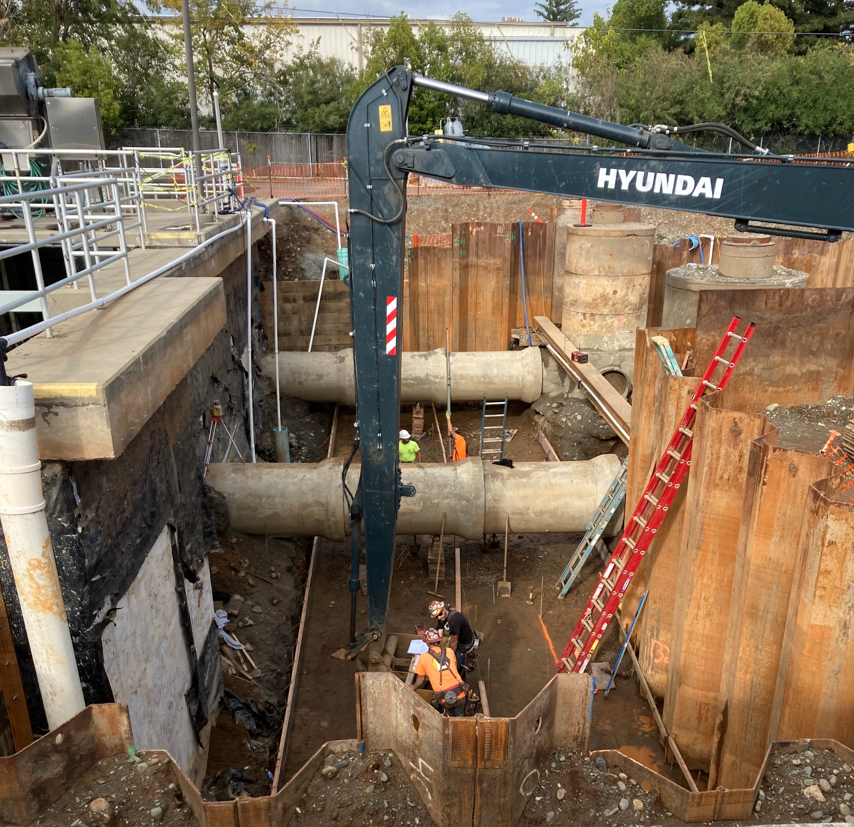
Building Forms for Sand Slurry Base

Slide 3
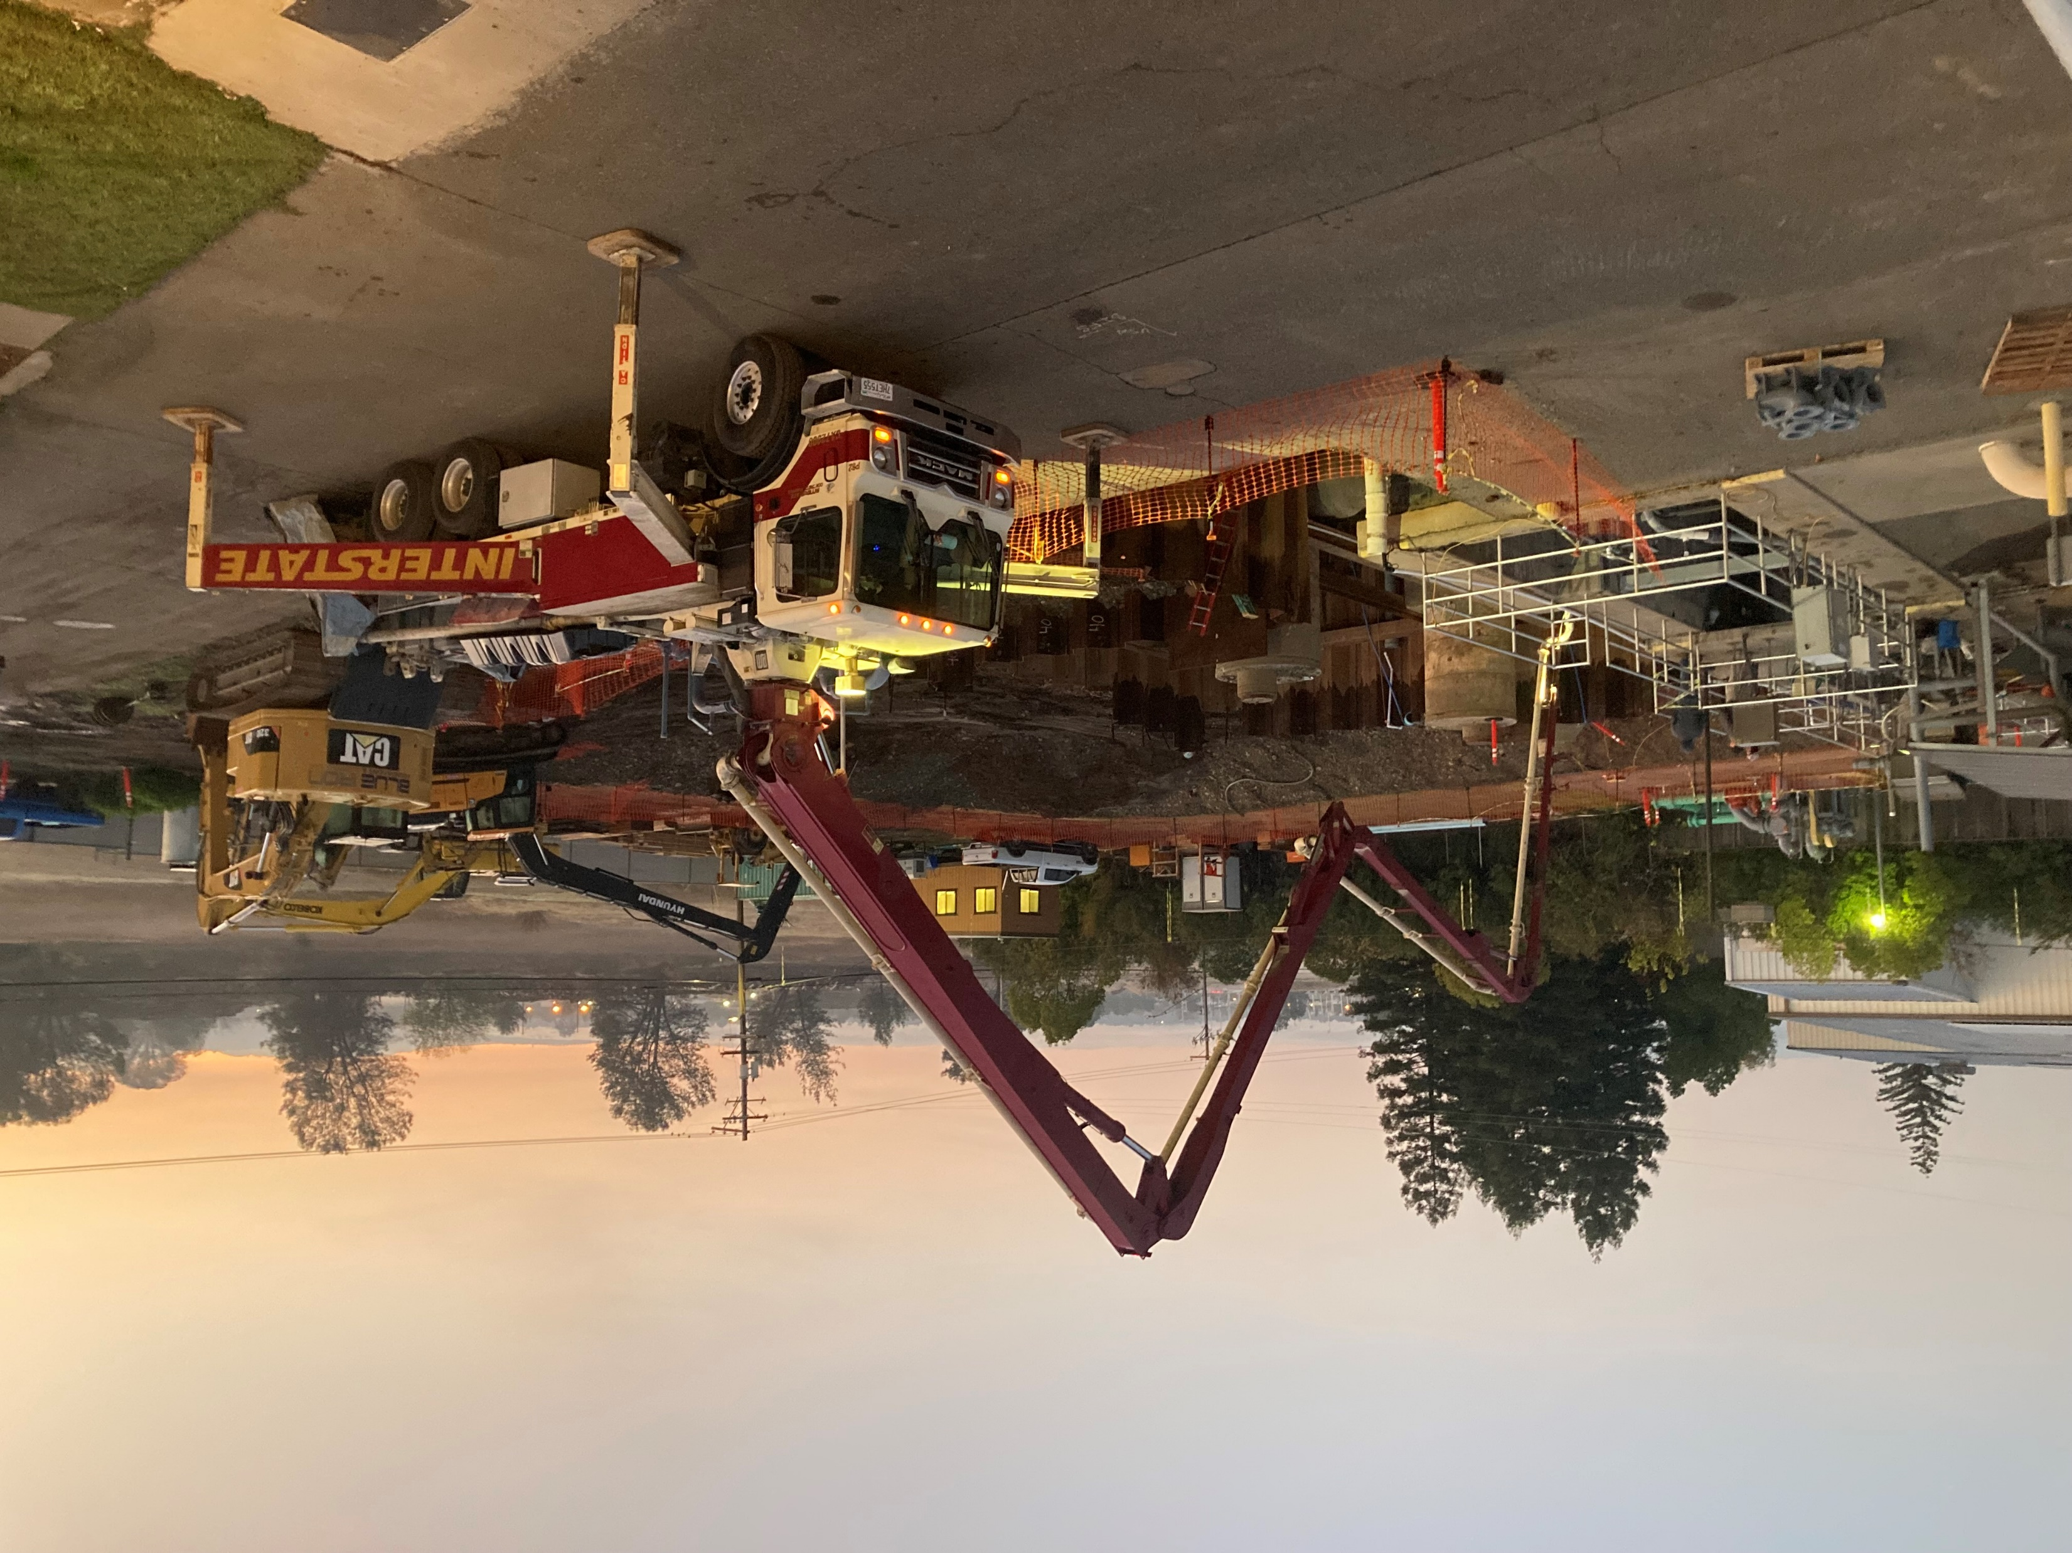
Pouring Concrete

Slide 4
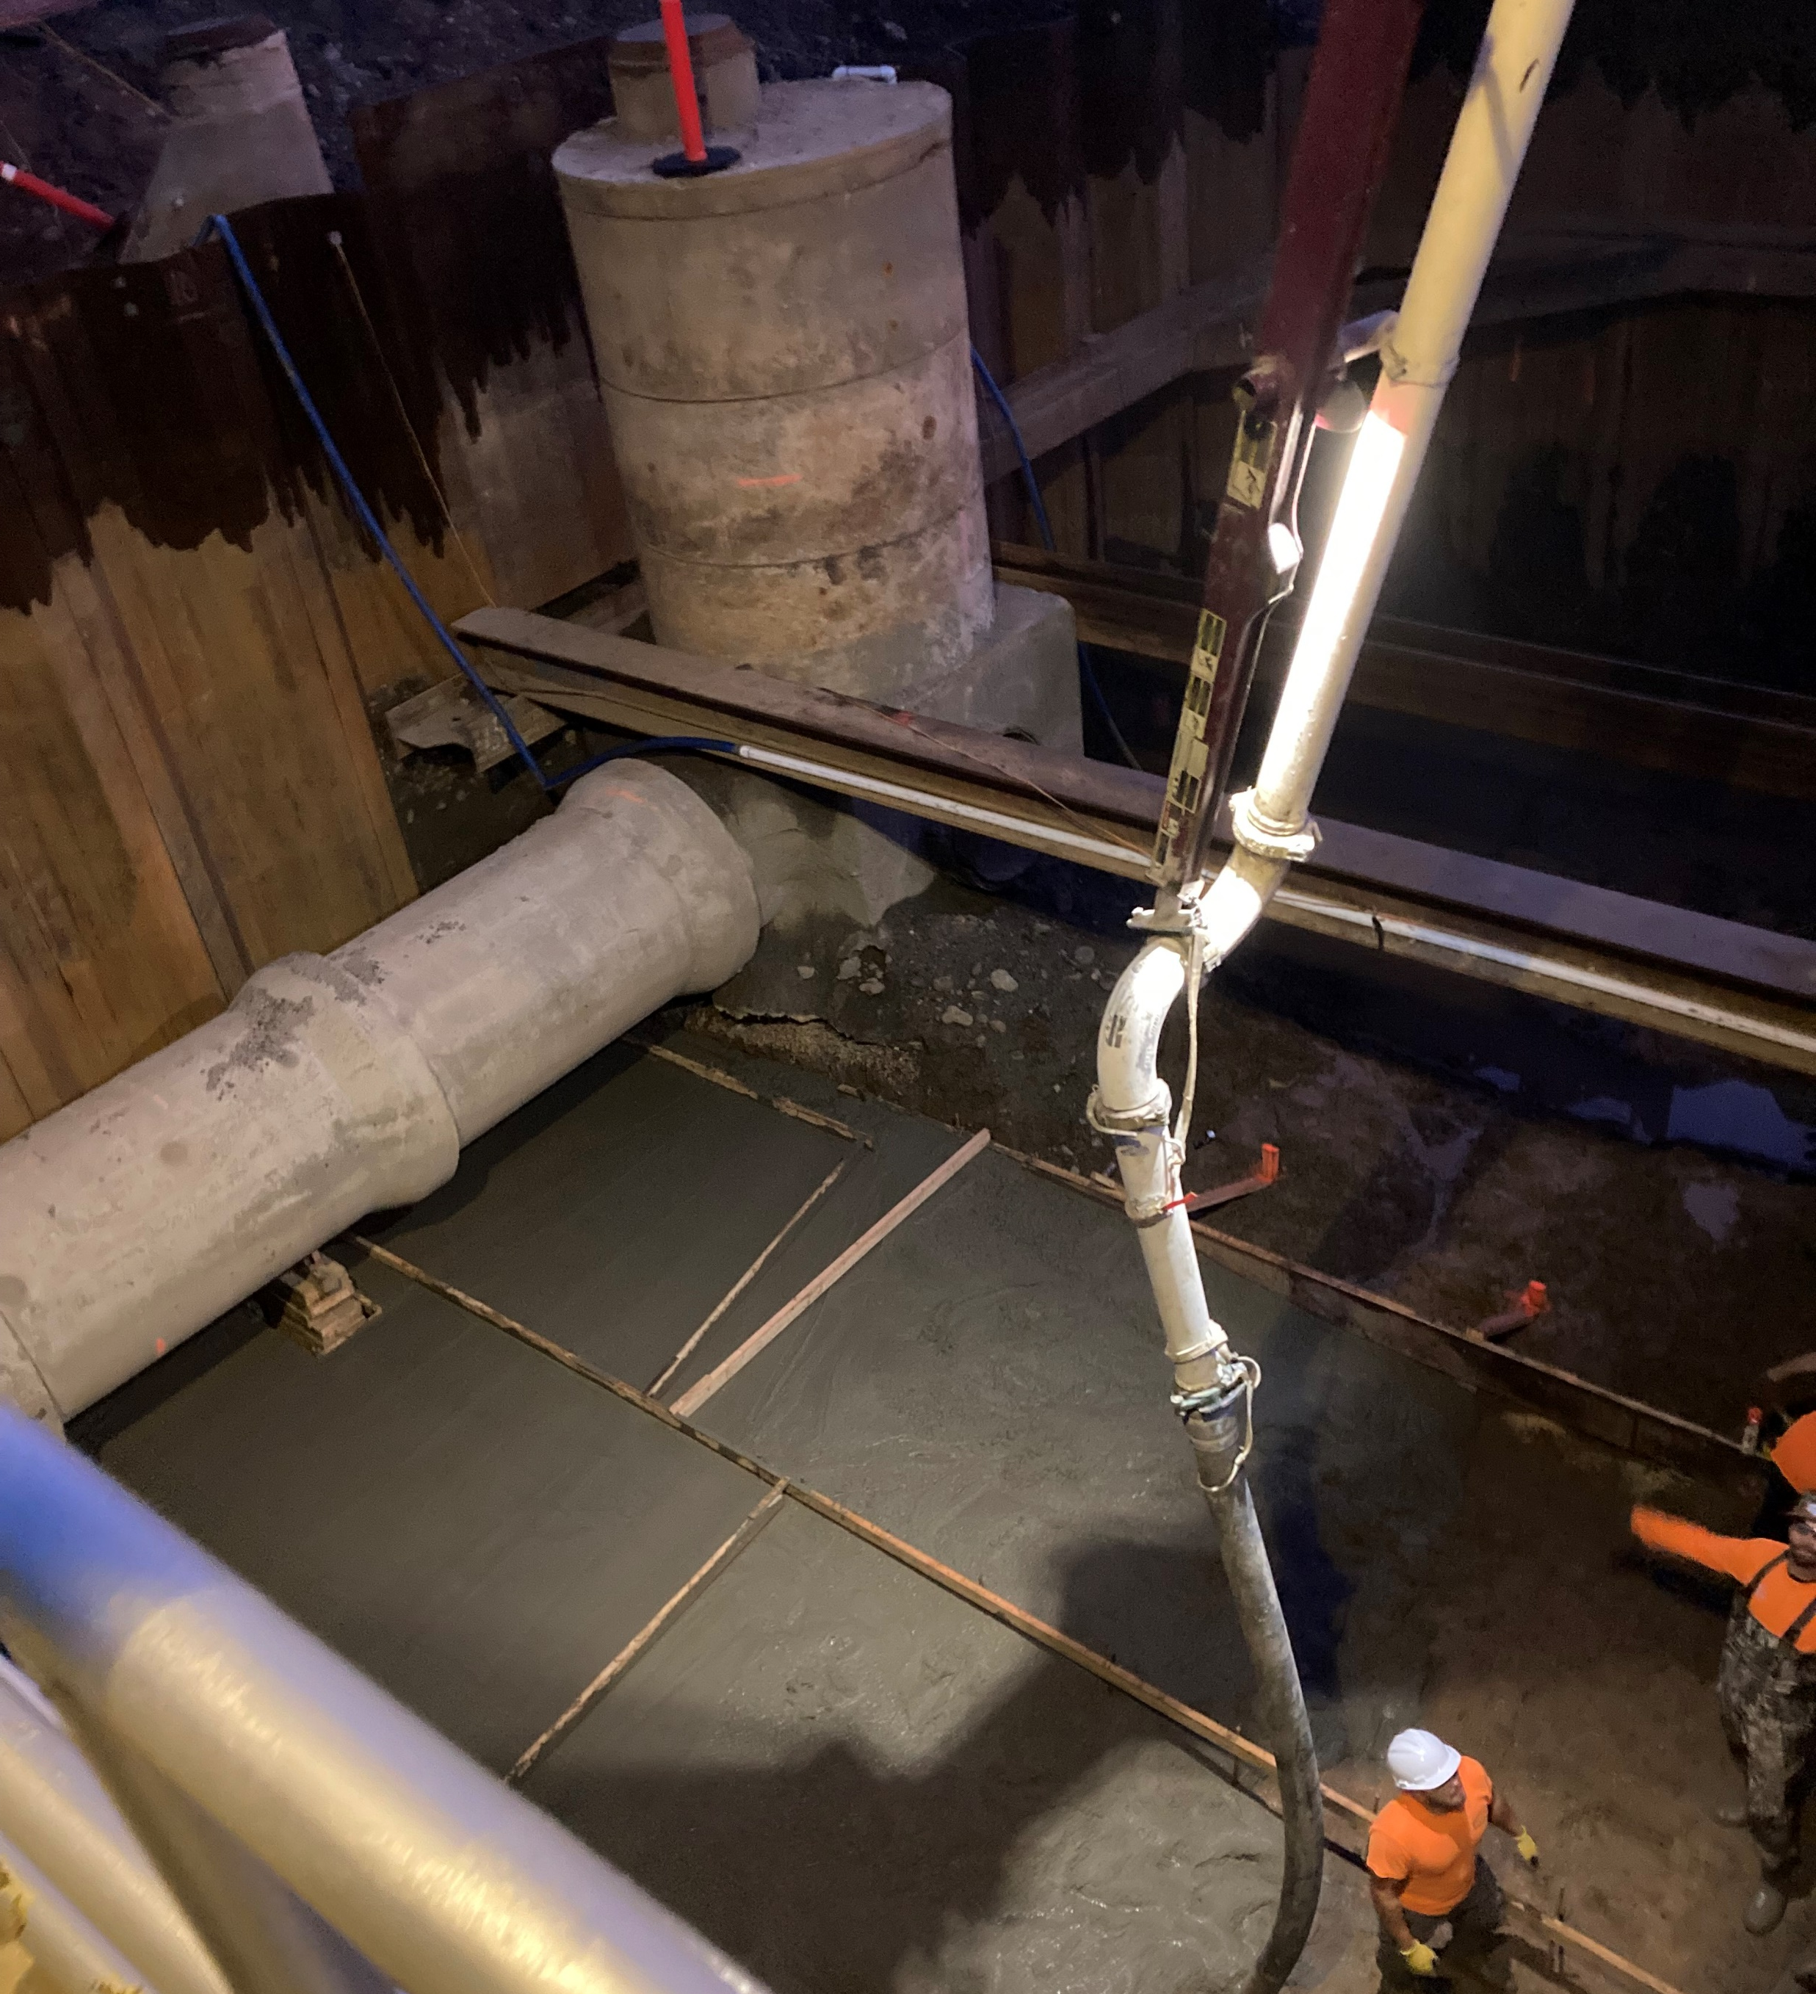

Slide 5
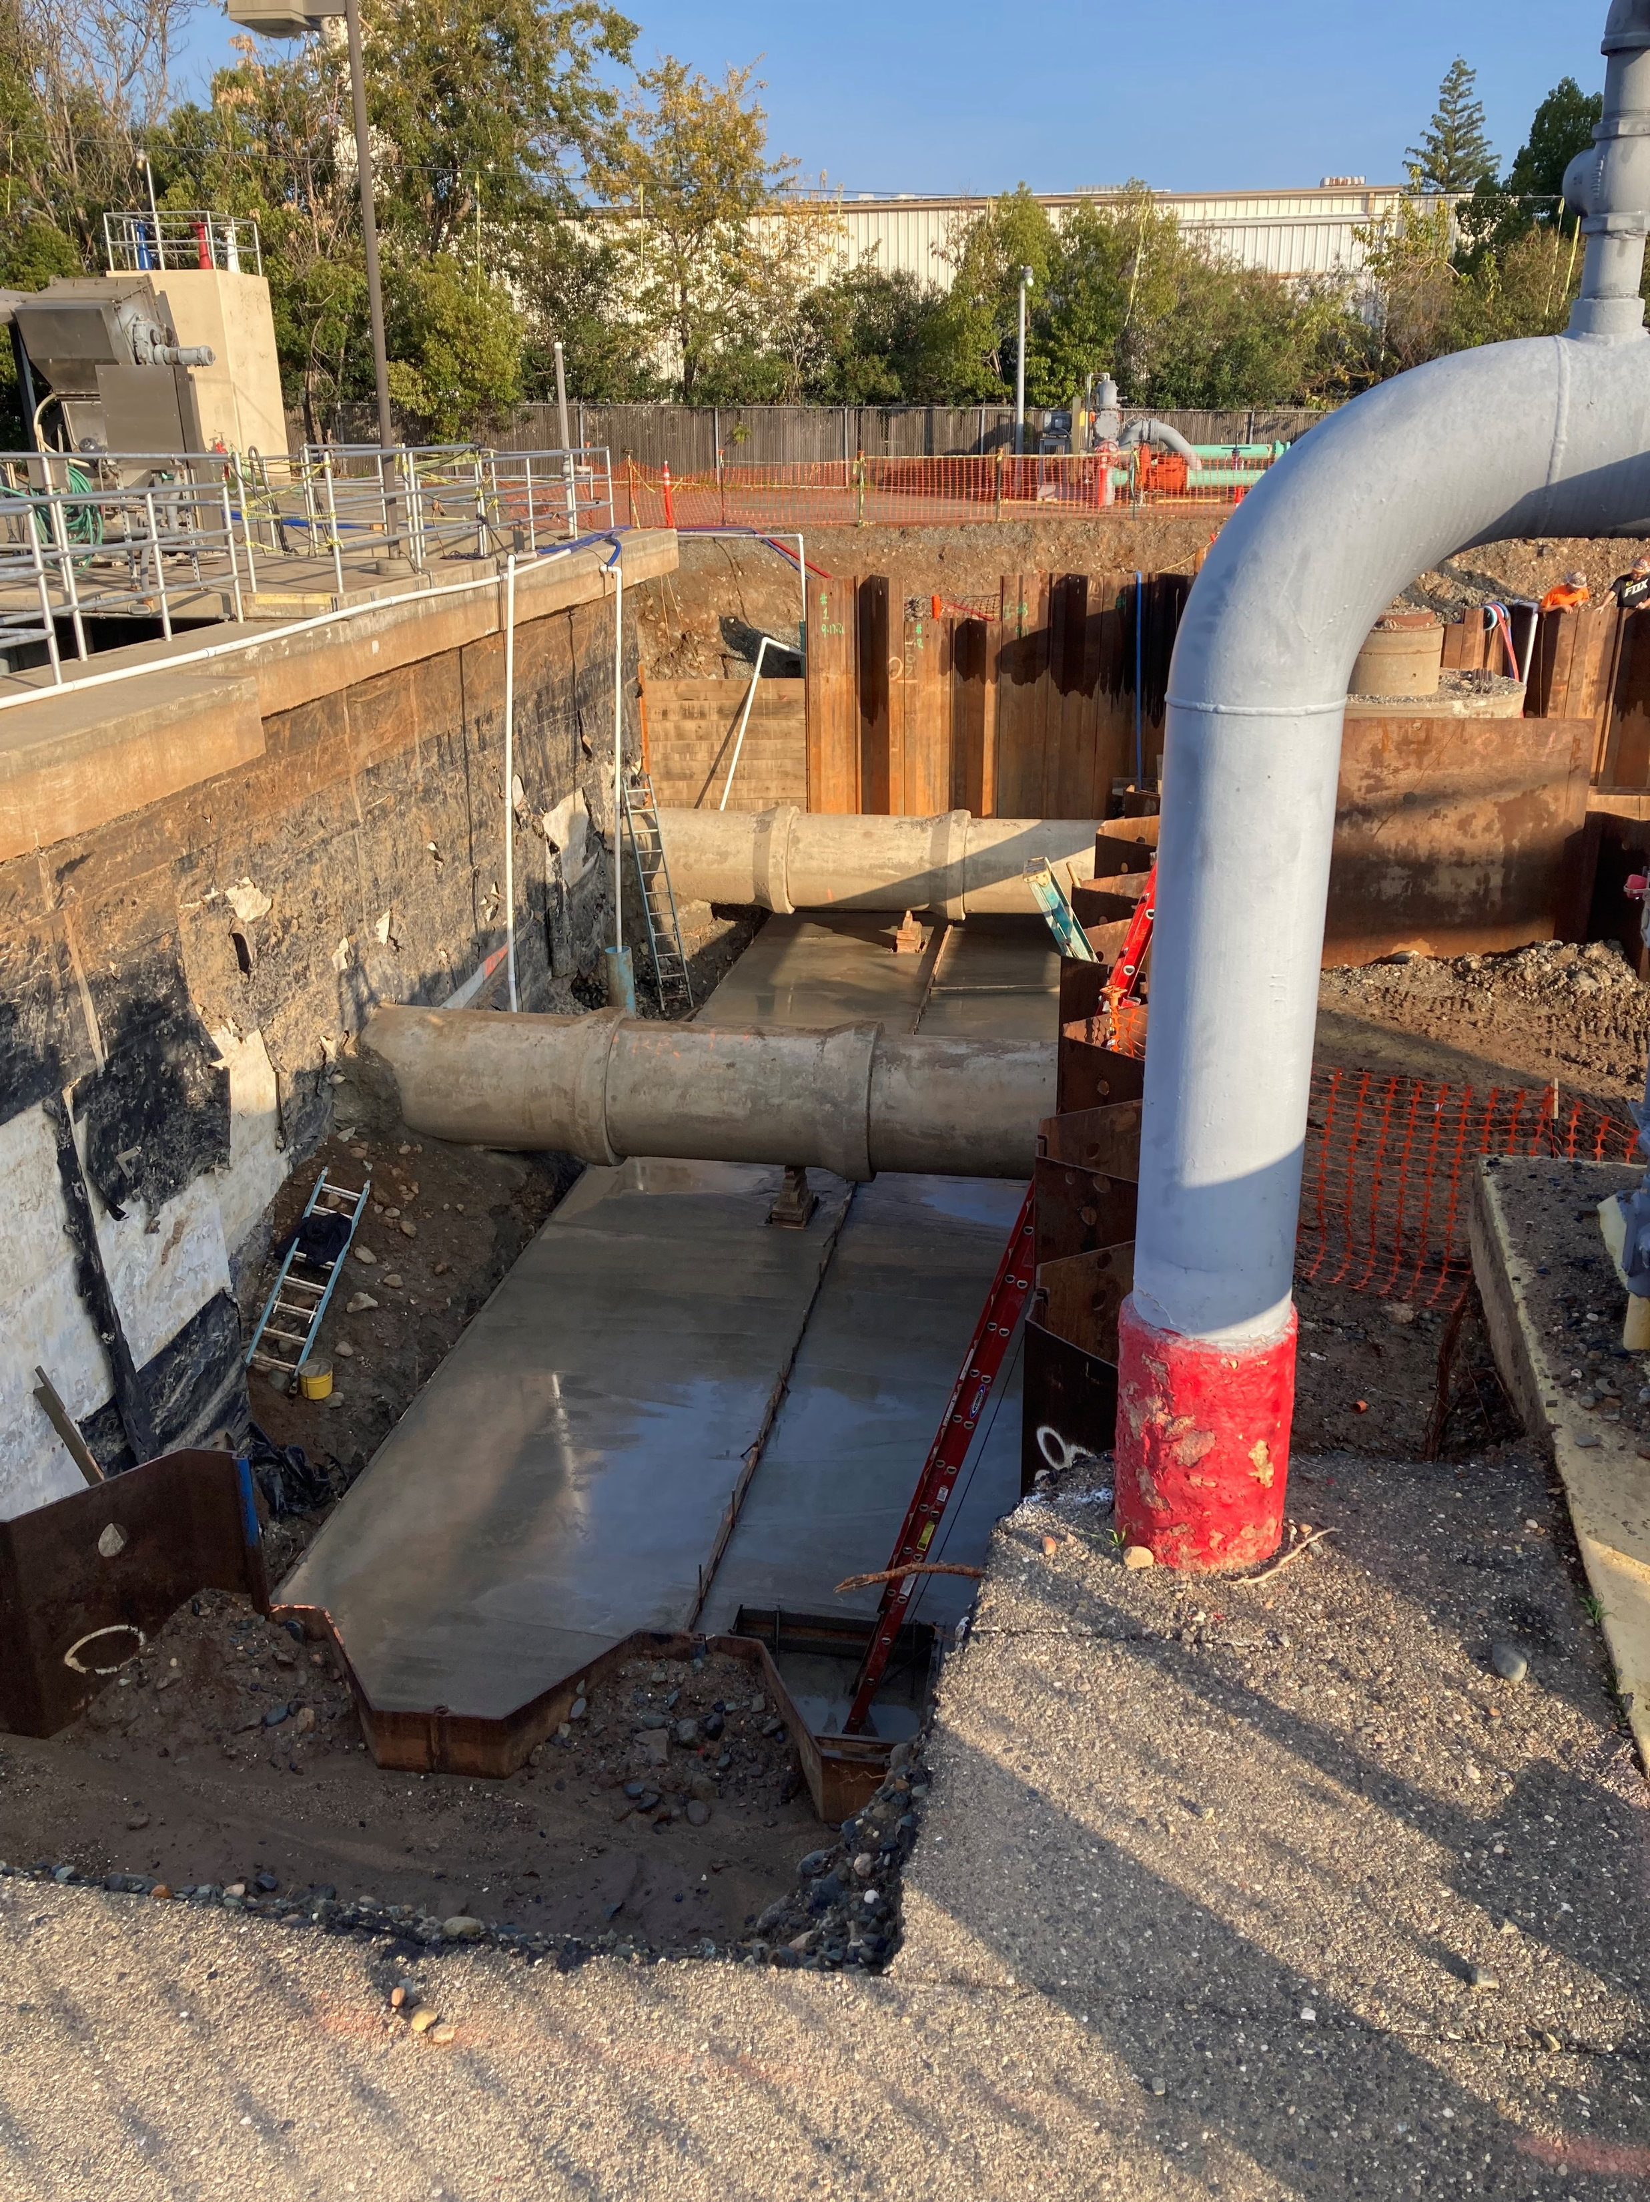

Slide 6
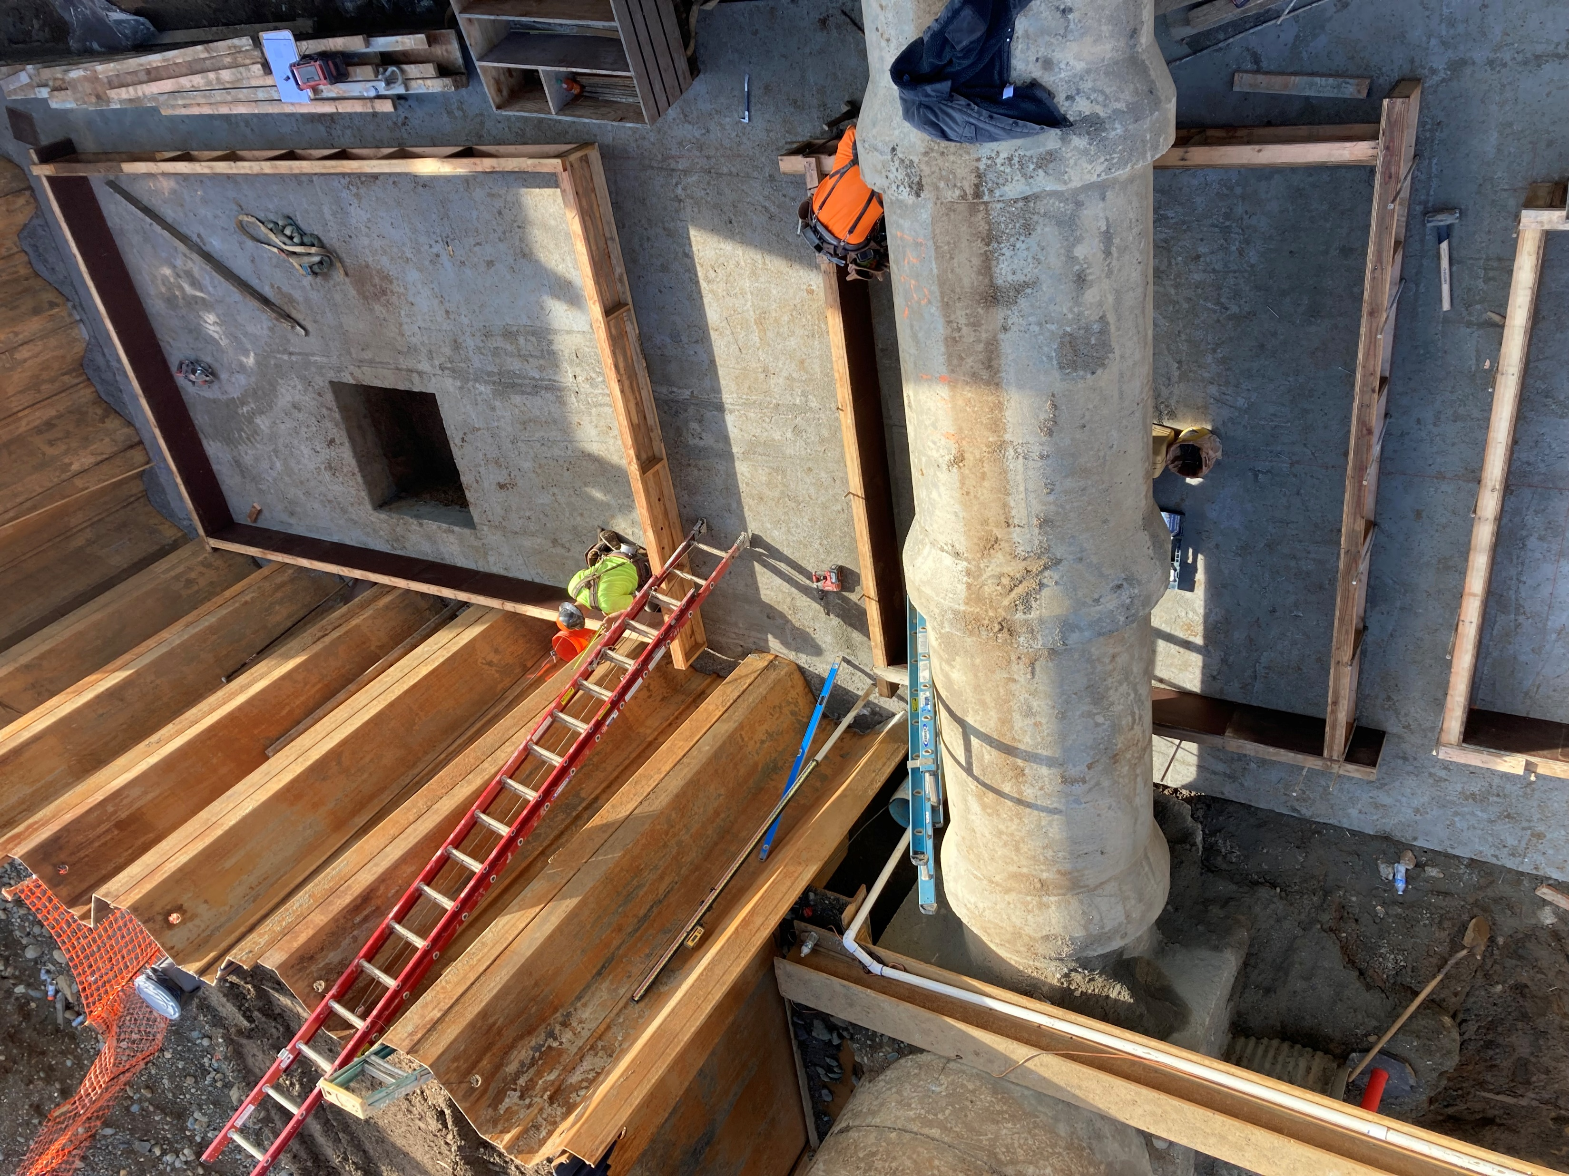
Forms For Valve Box Flow Meter Foundations

Slide 7
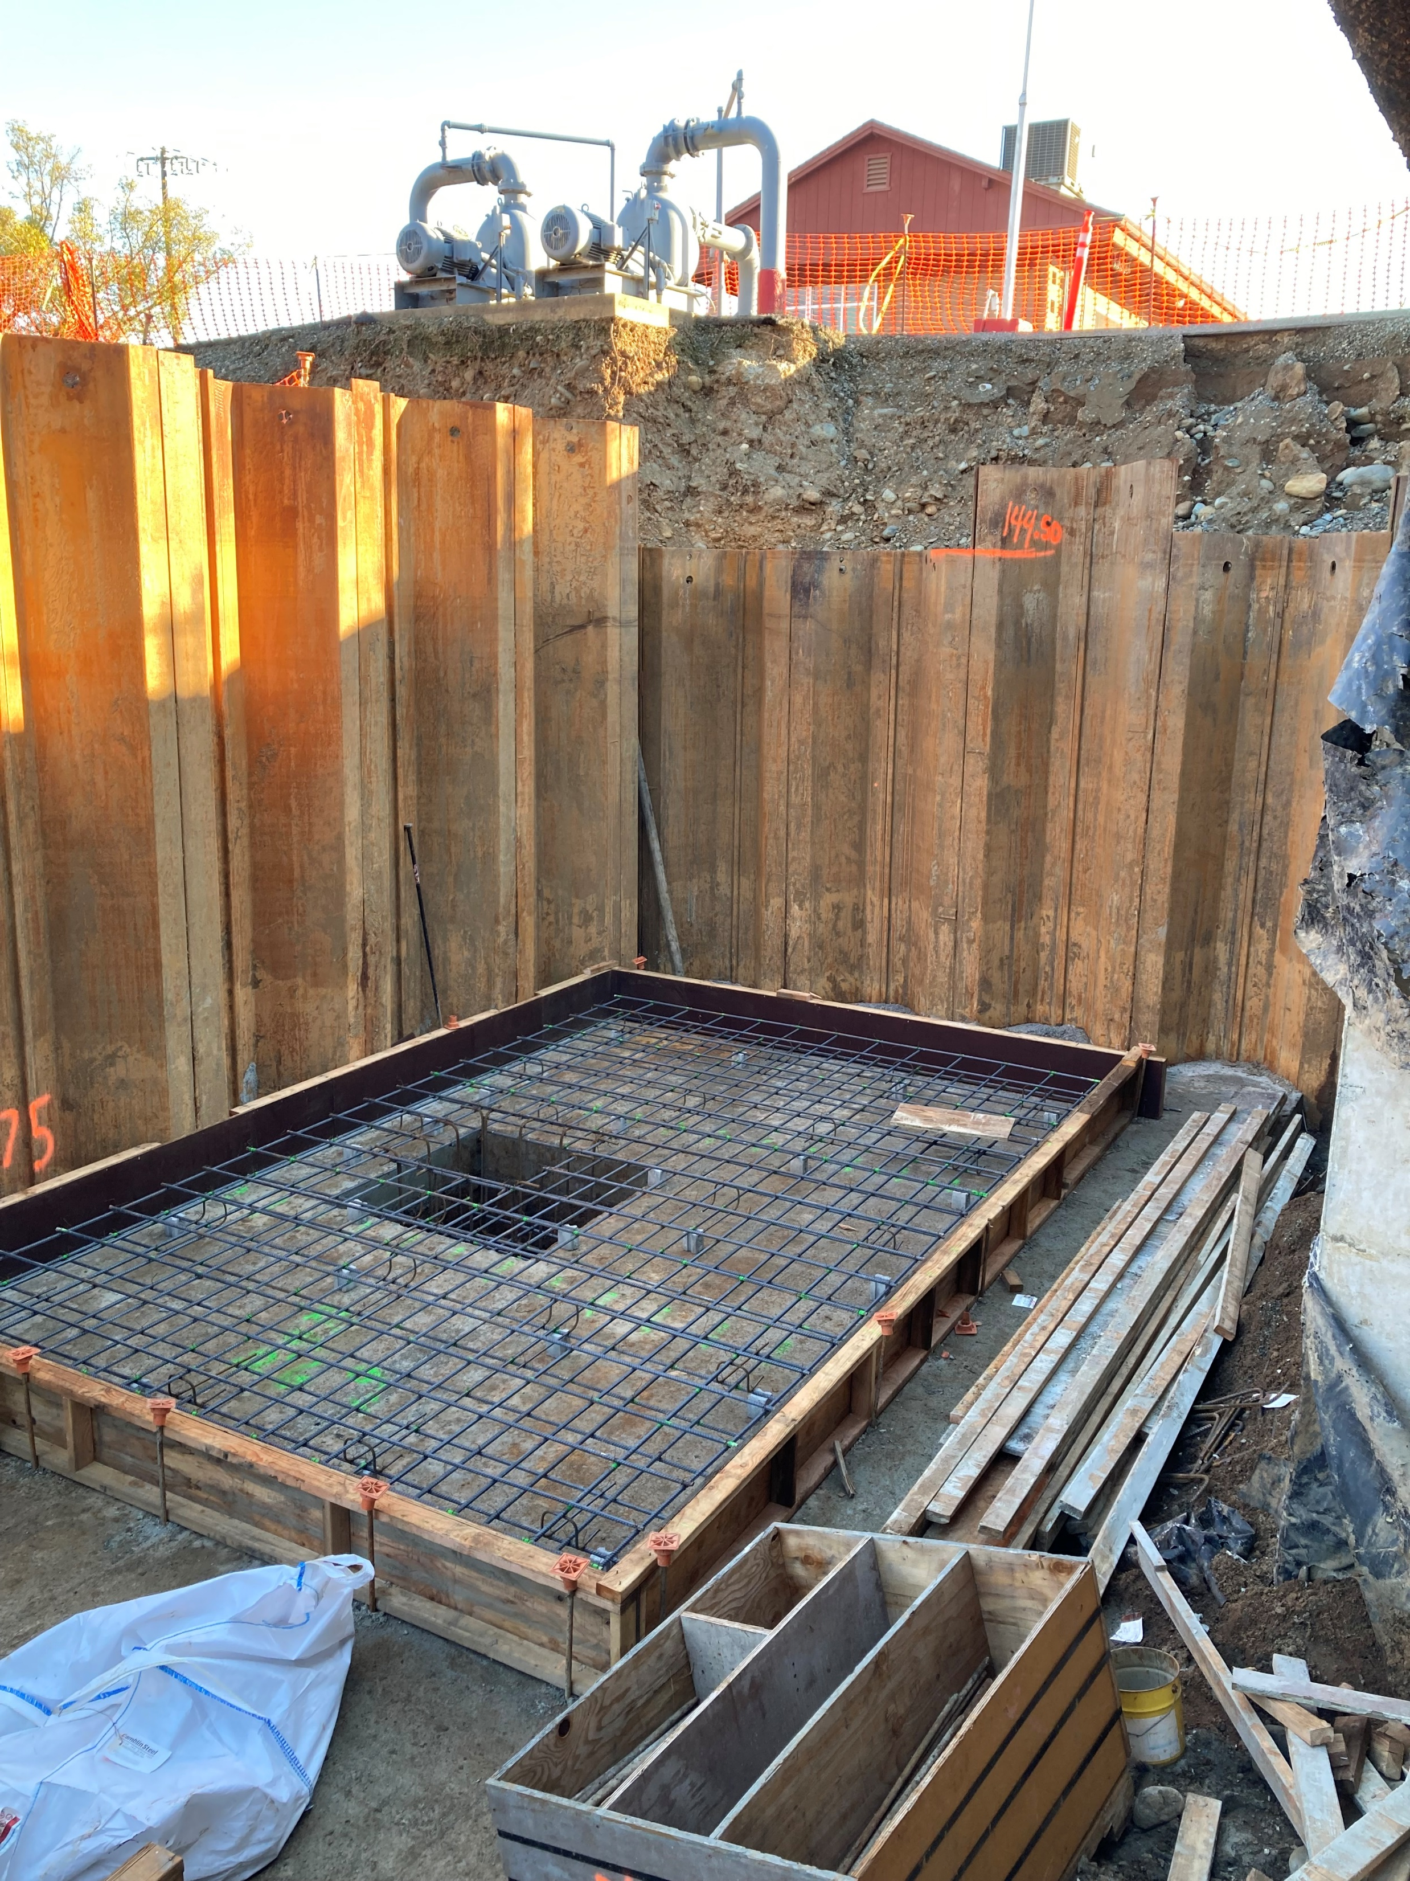
Tying Rebar

Slide 8
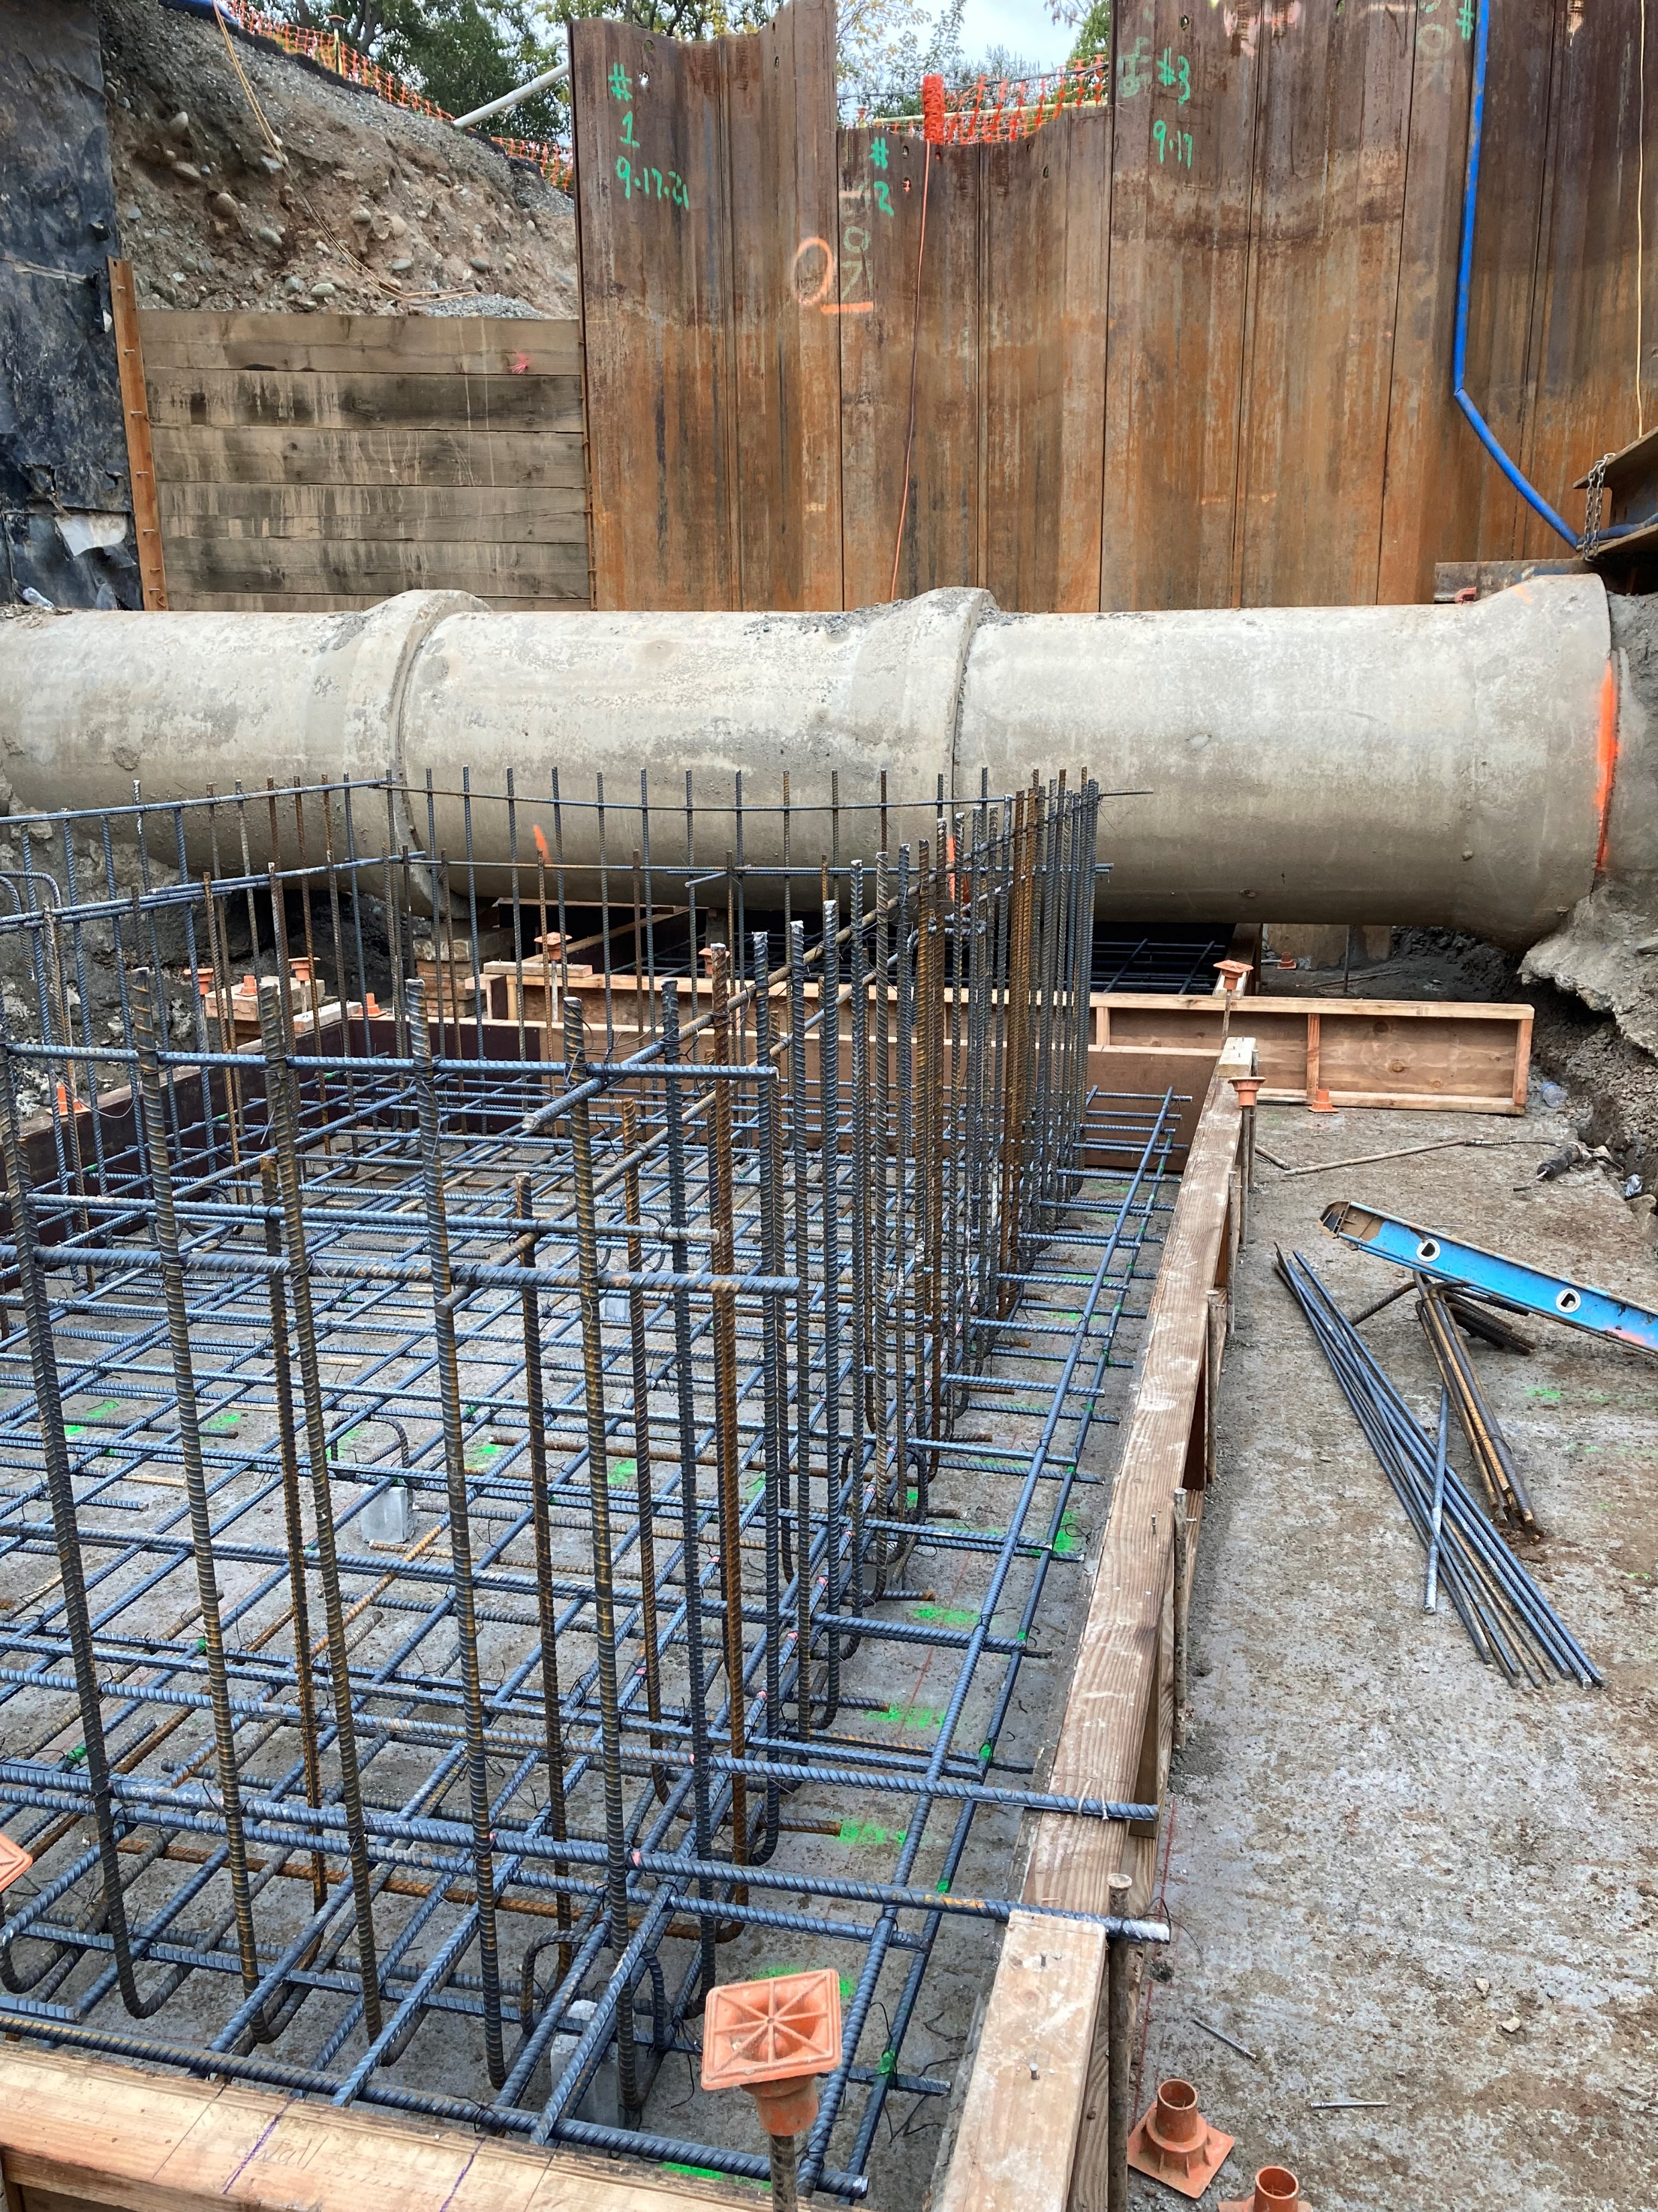

Slide 9
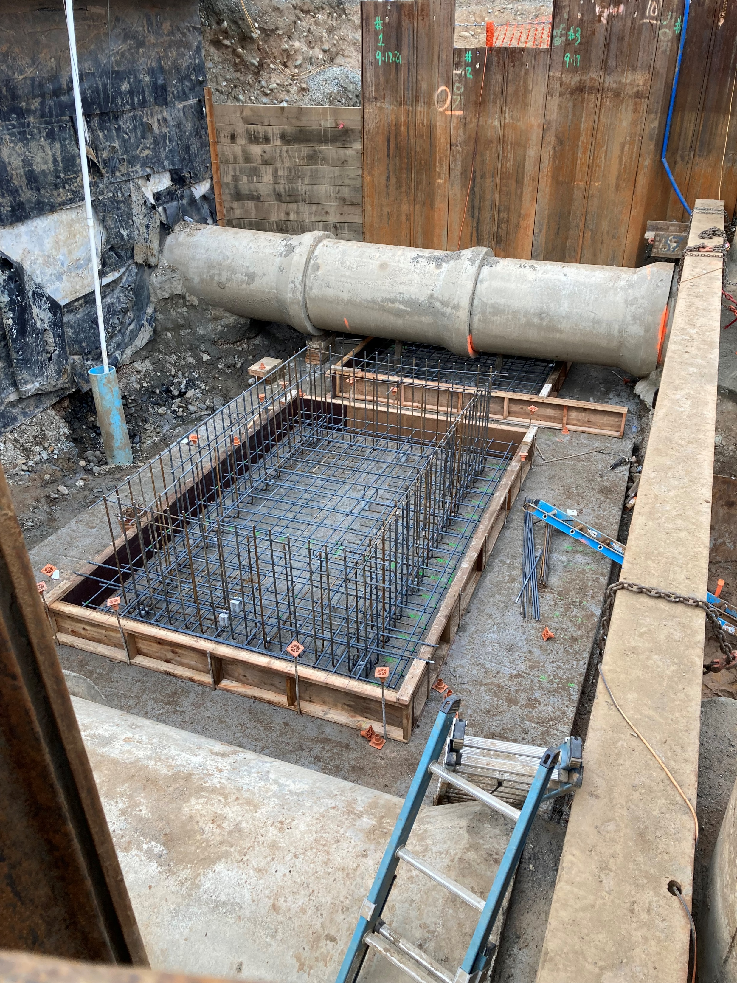

Slide 10
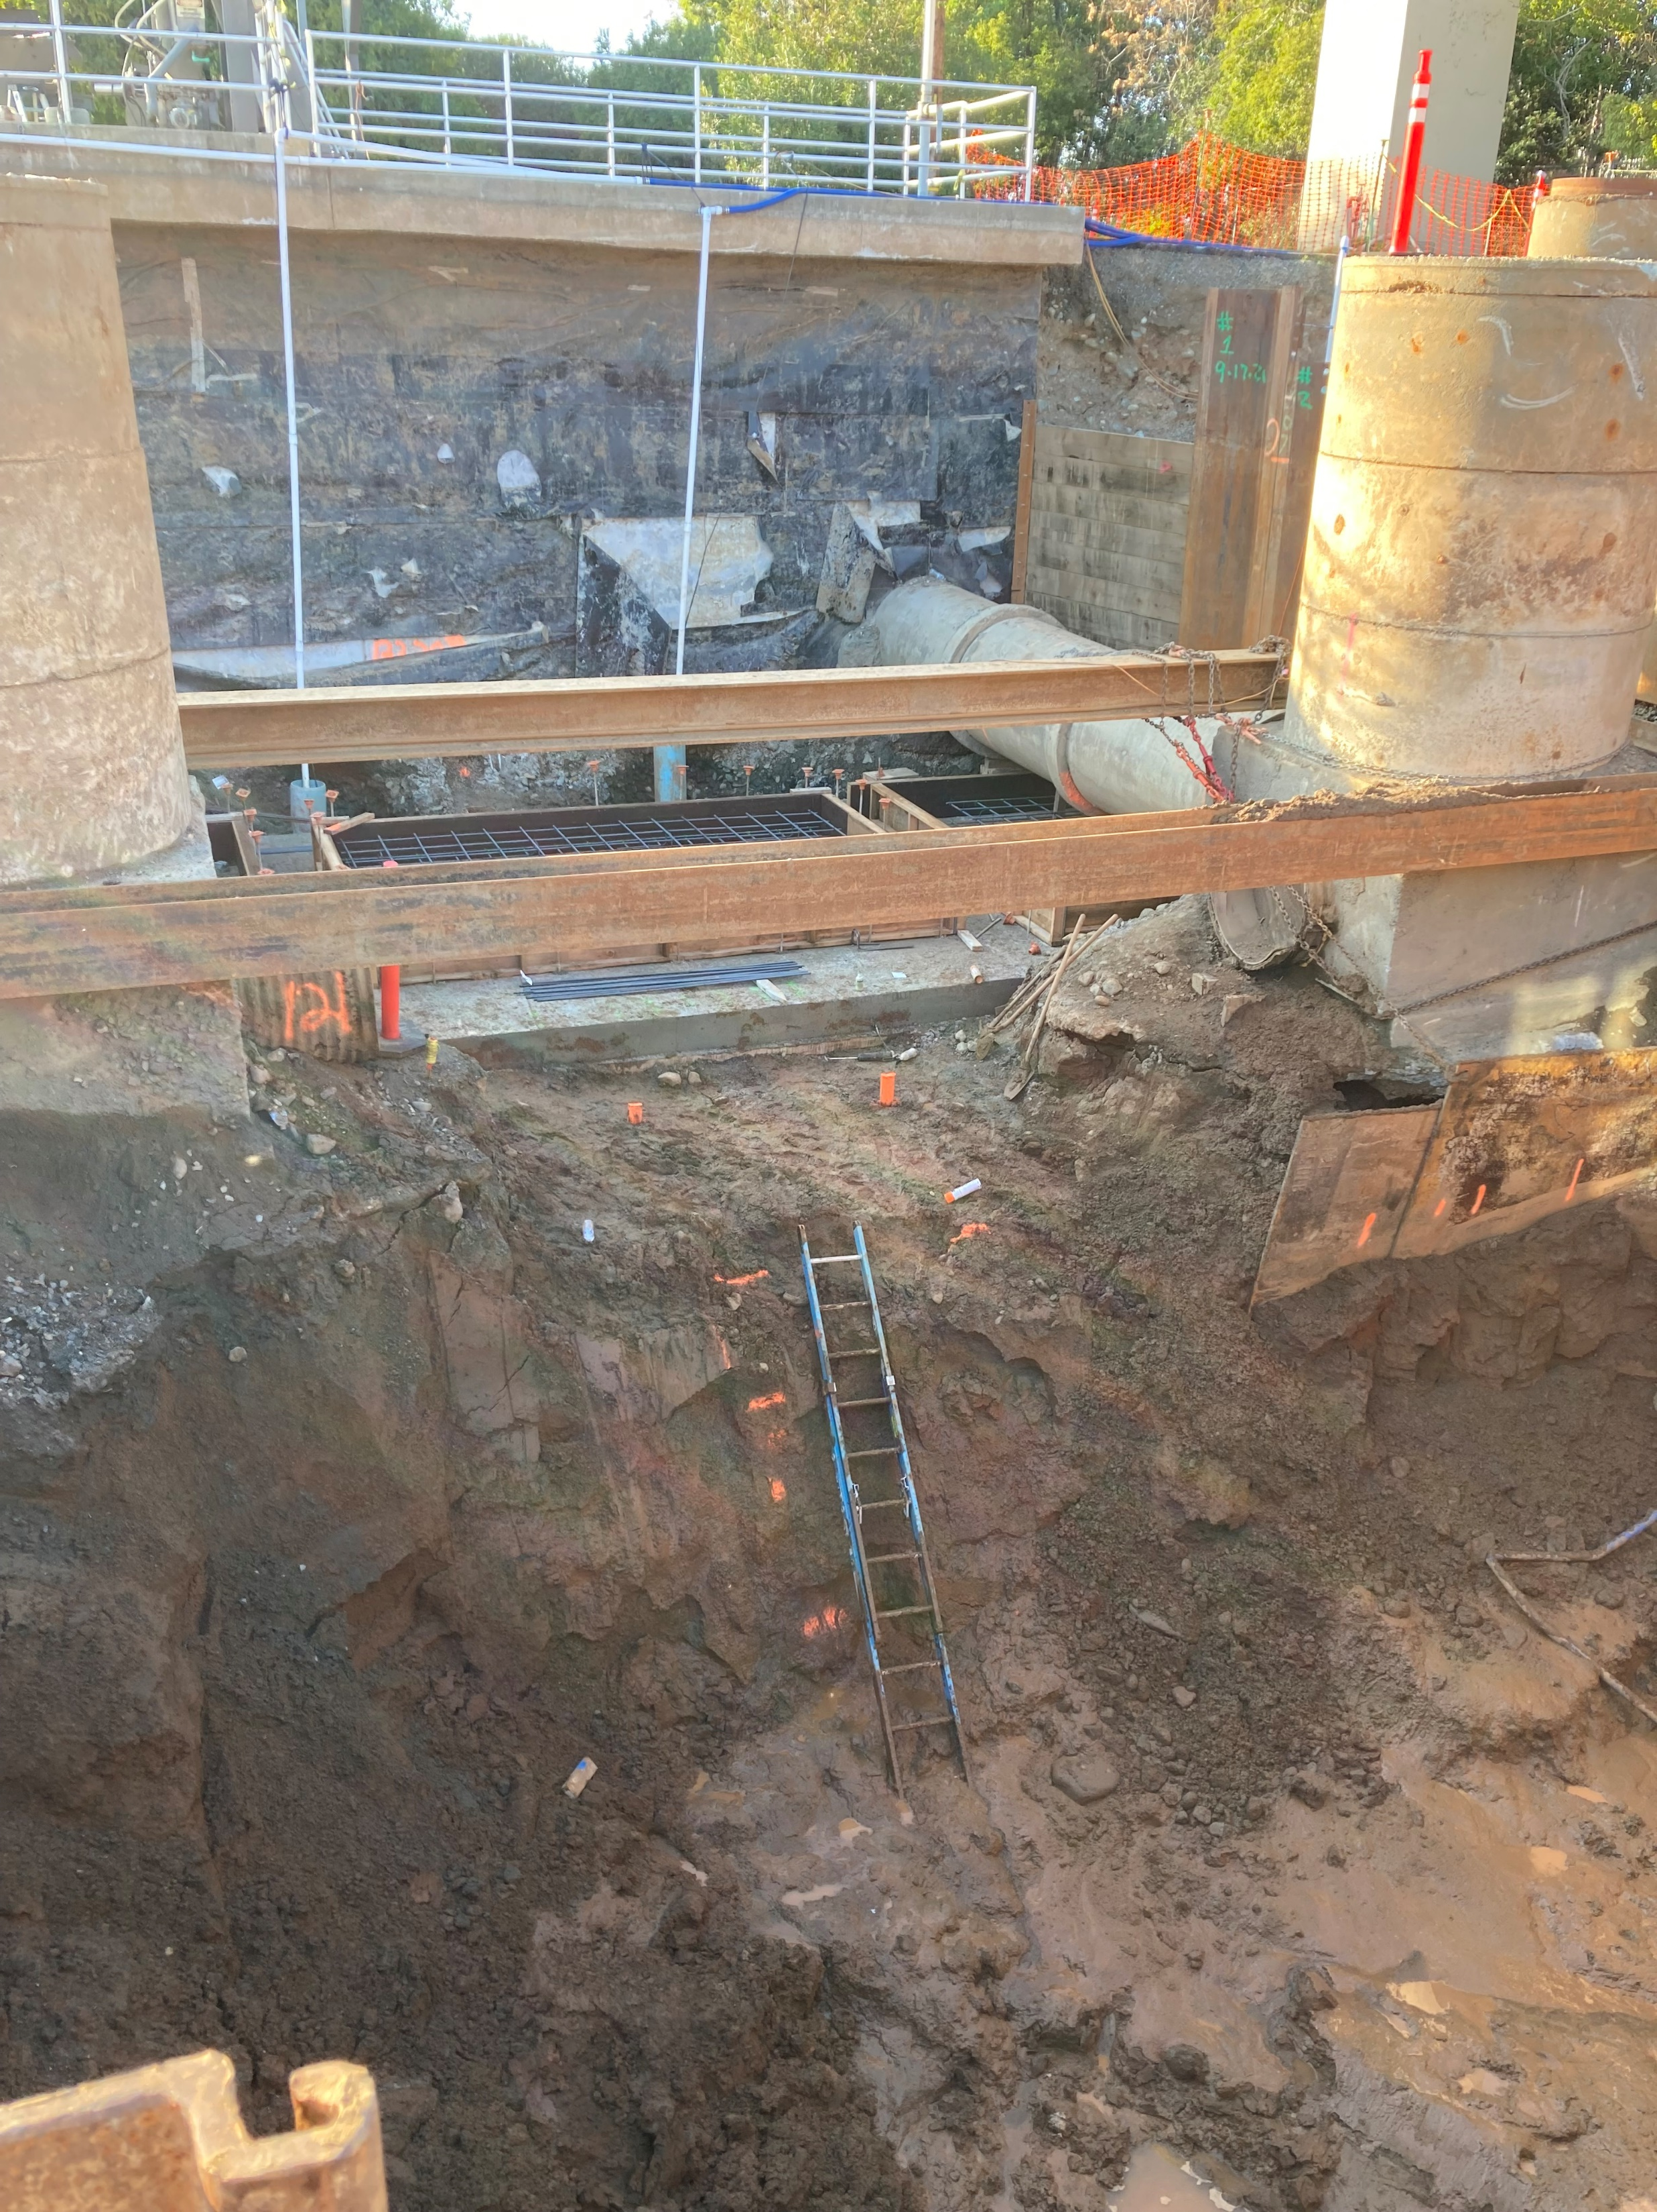
Continuing Excavation for Wet Well

