Slide 1
January 2022
SC-OR Influent Pump Station Project

Slide 2
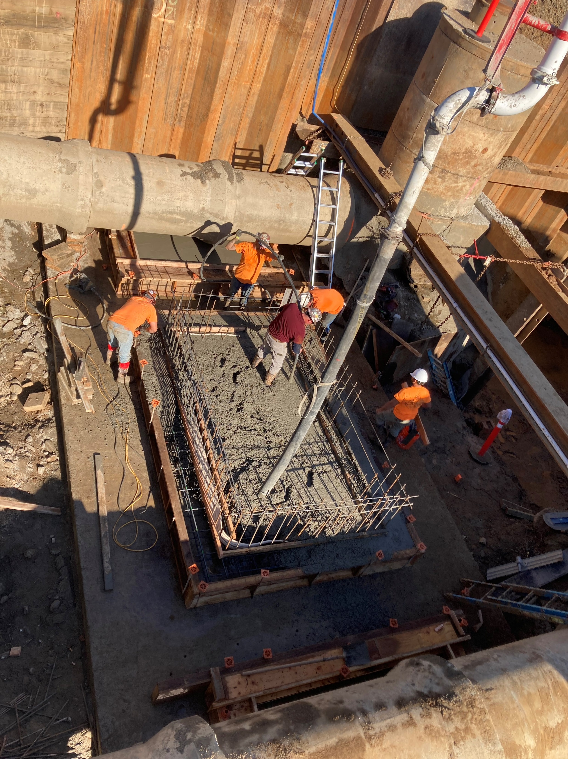
Pouring Foundations

Slide 3
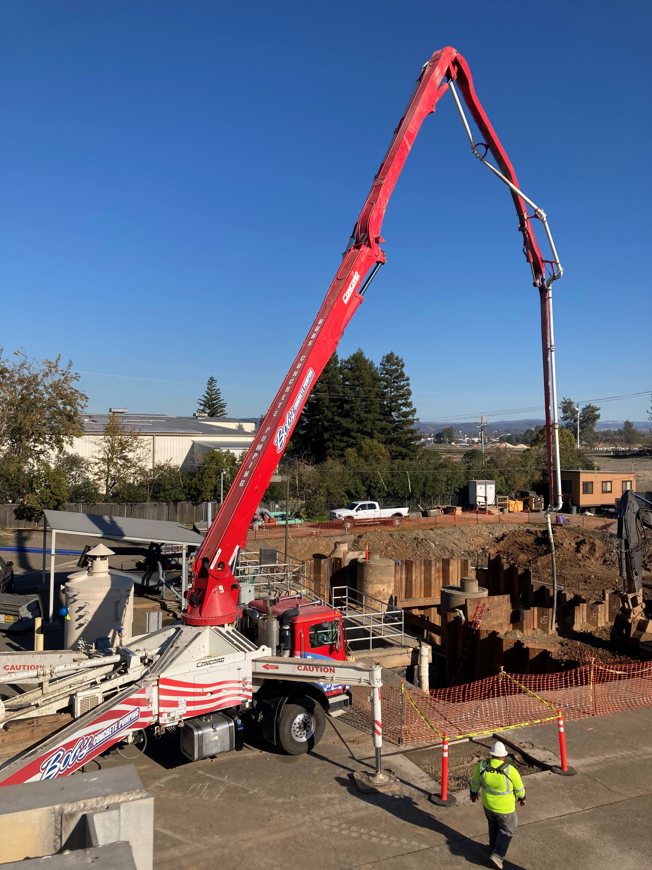

Slide 4
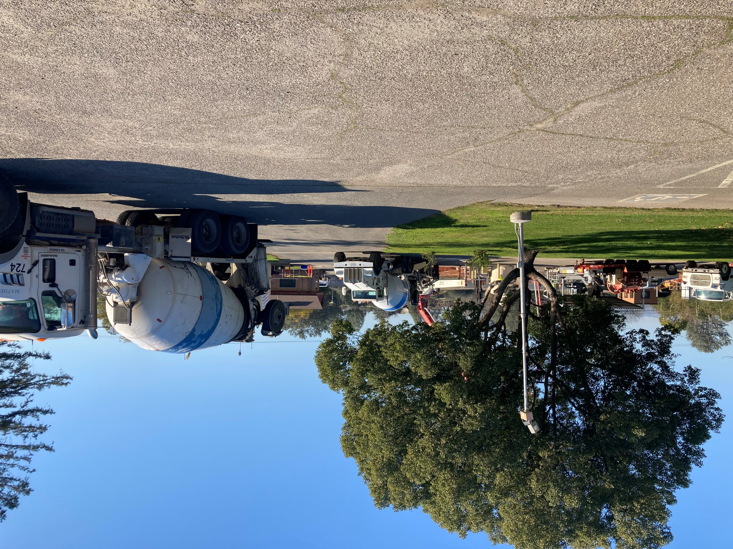
Lining Up Concrete Trucks at the Pumper Truck

Slide 5
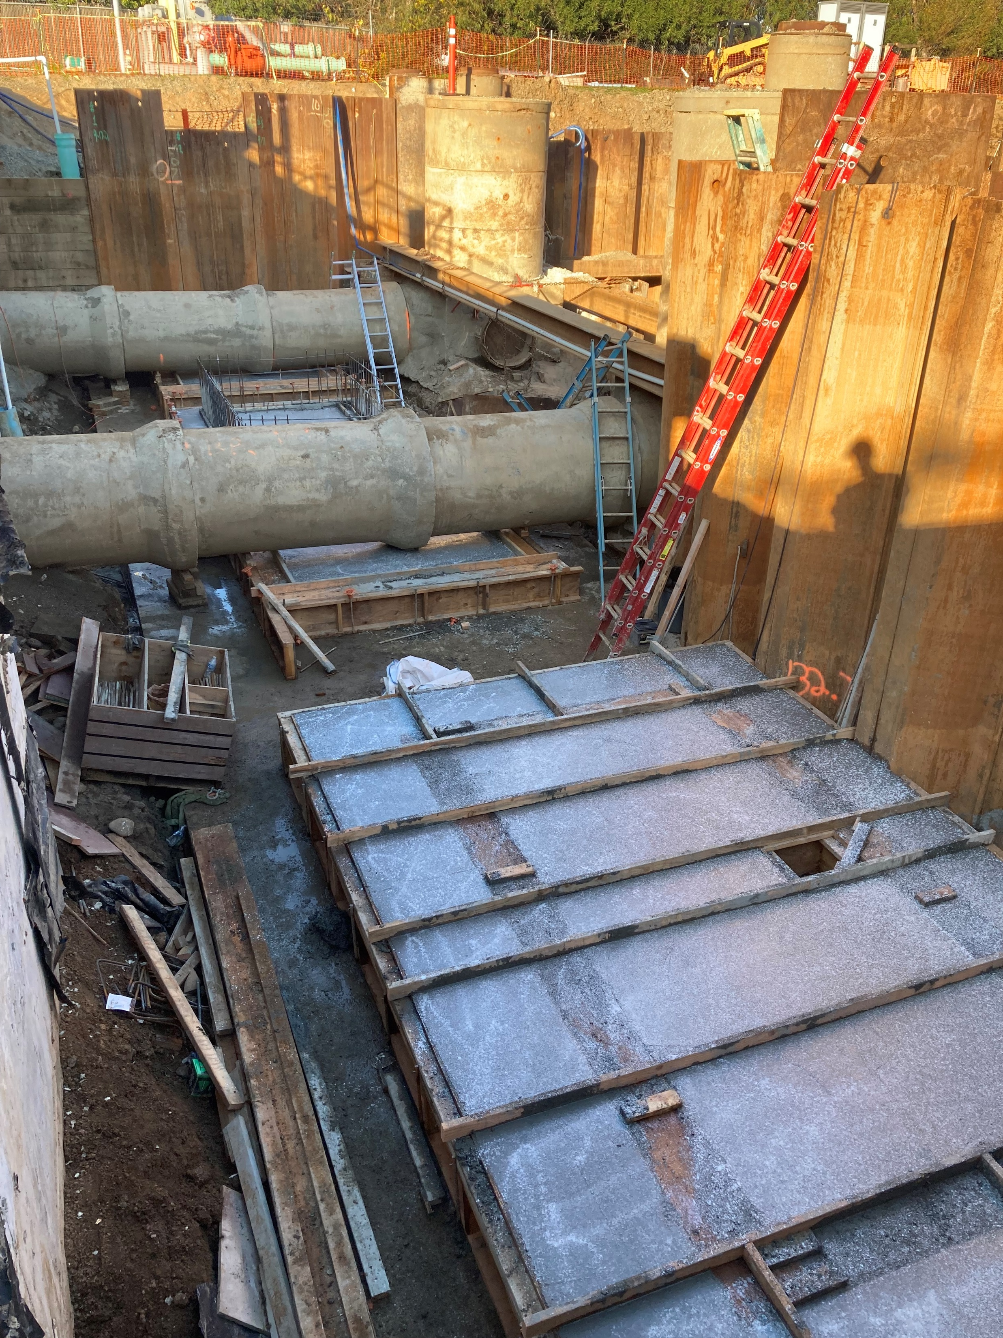
Foundations Poured

Slide 6
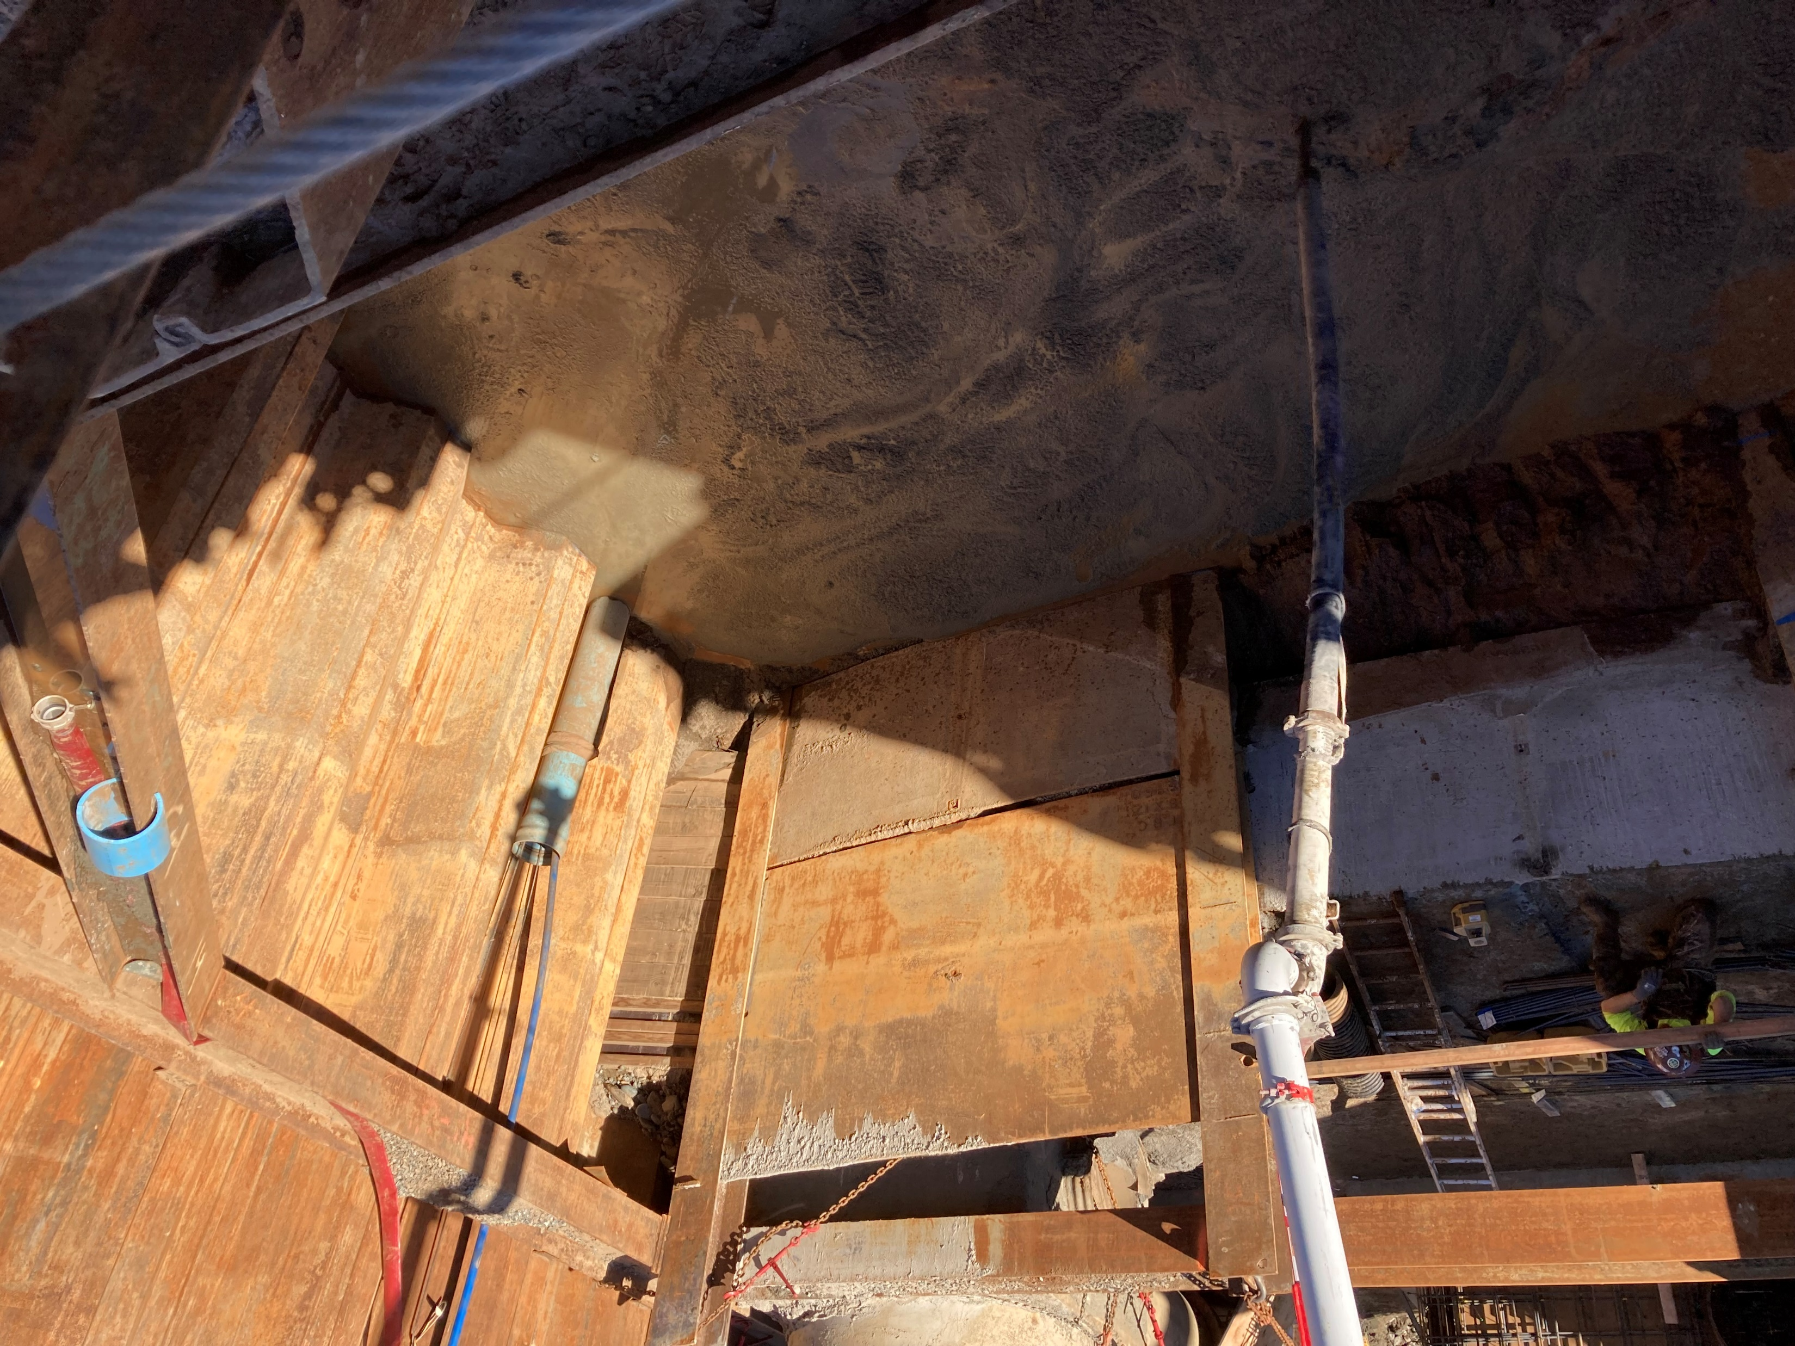
Concrete Slurry for the Base of the New Wet Well

Slide 7
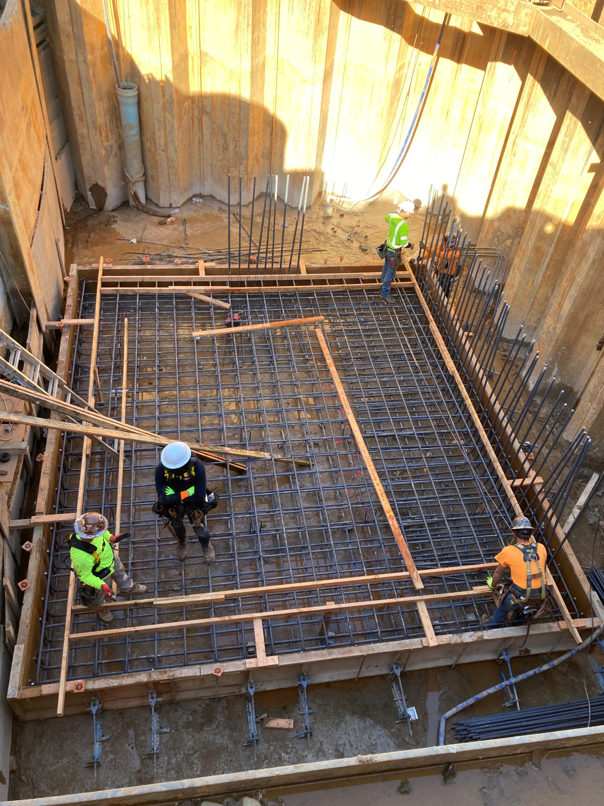
Framing the Foundation of the New Wet Well

Slide 8
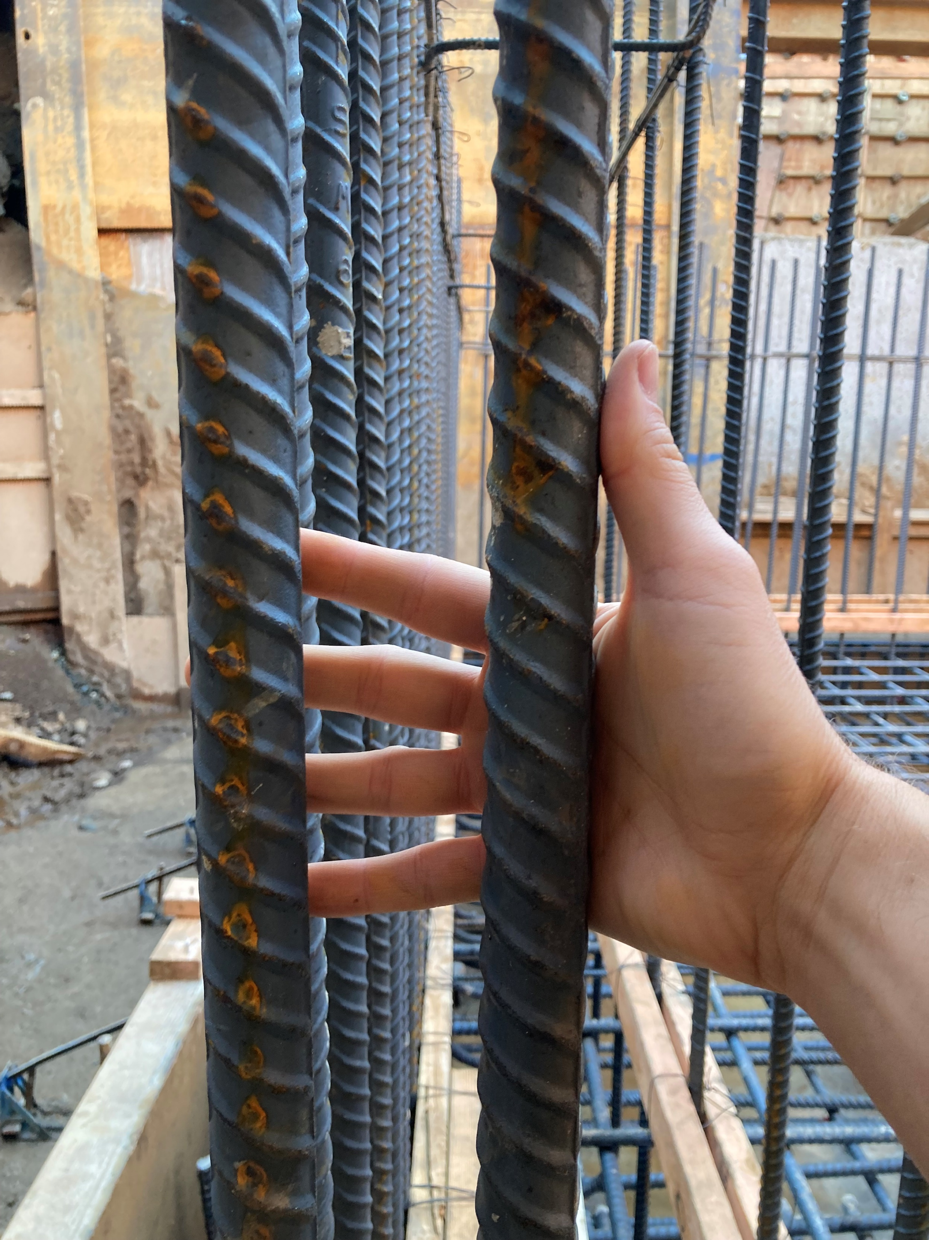
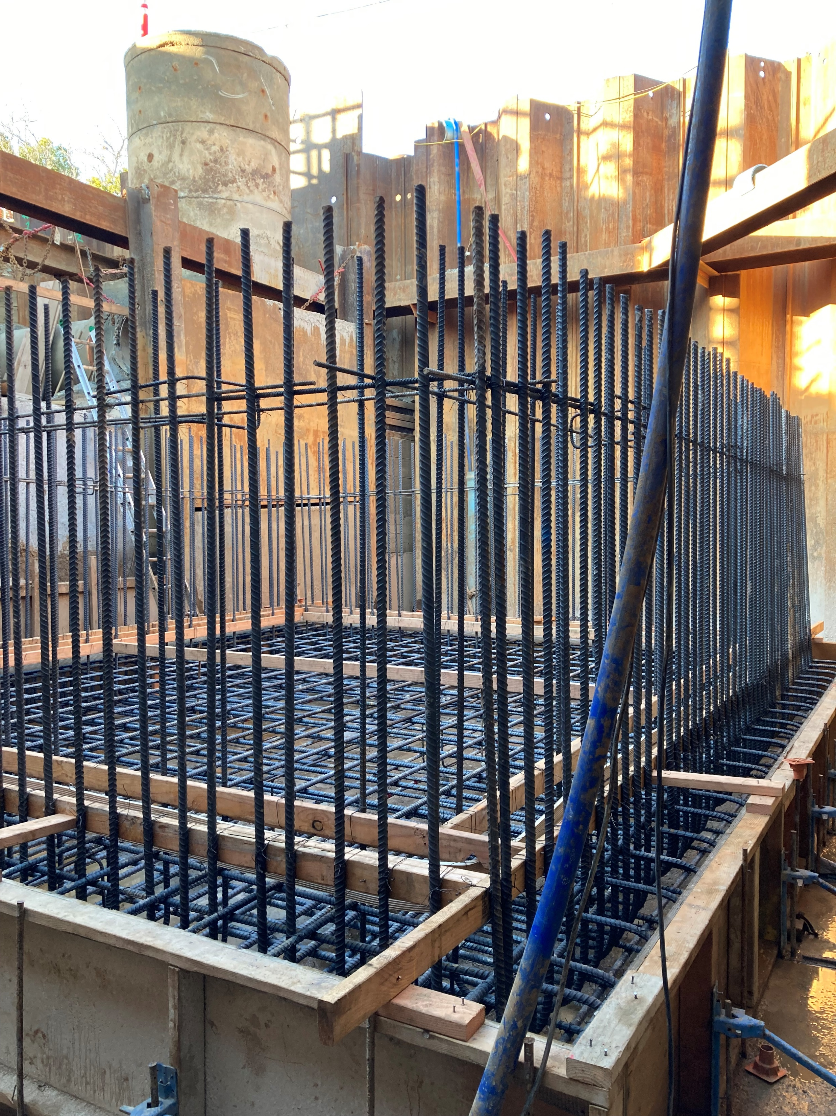
Rebar in the New Wet Well

Slide 9
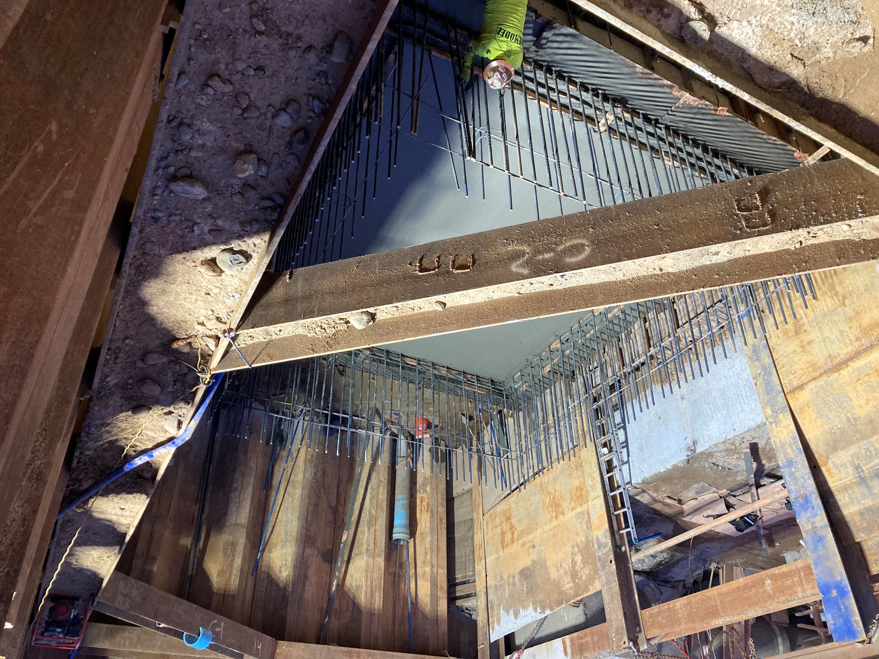
Foundation of the New Wet Well Poured

Slide 10
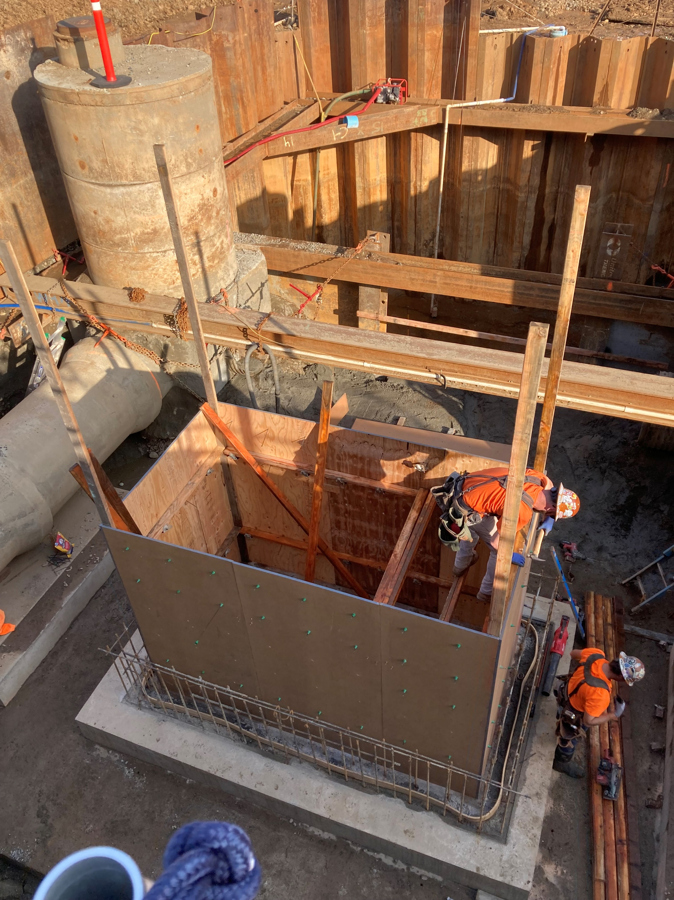
Framing the Inner Wall of the Bar Screen

Slide 11
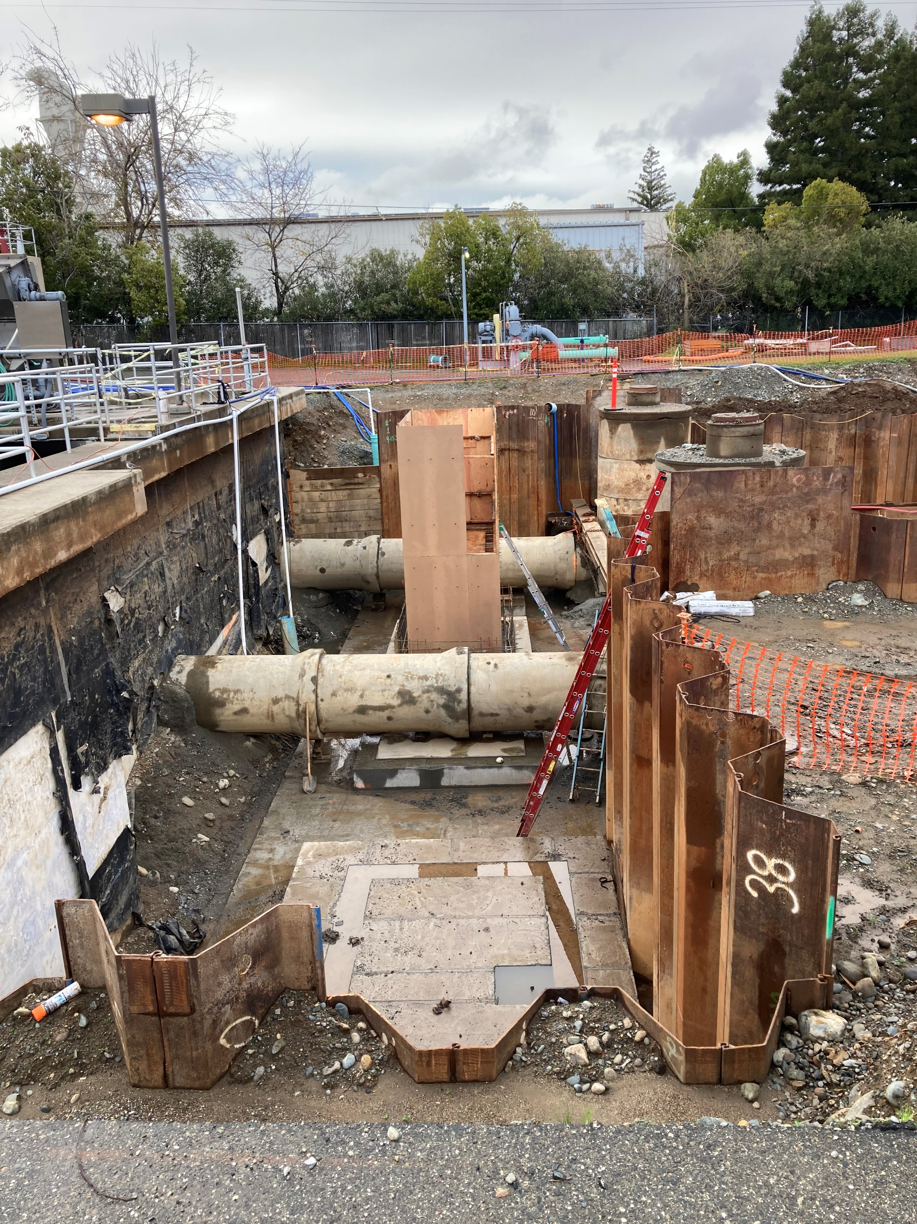

Slide 12
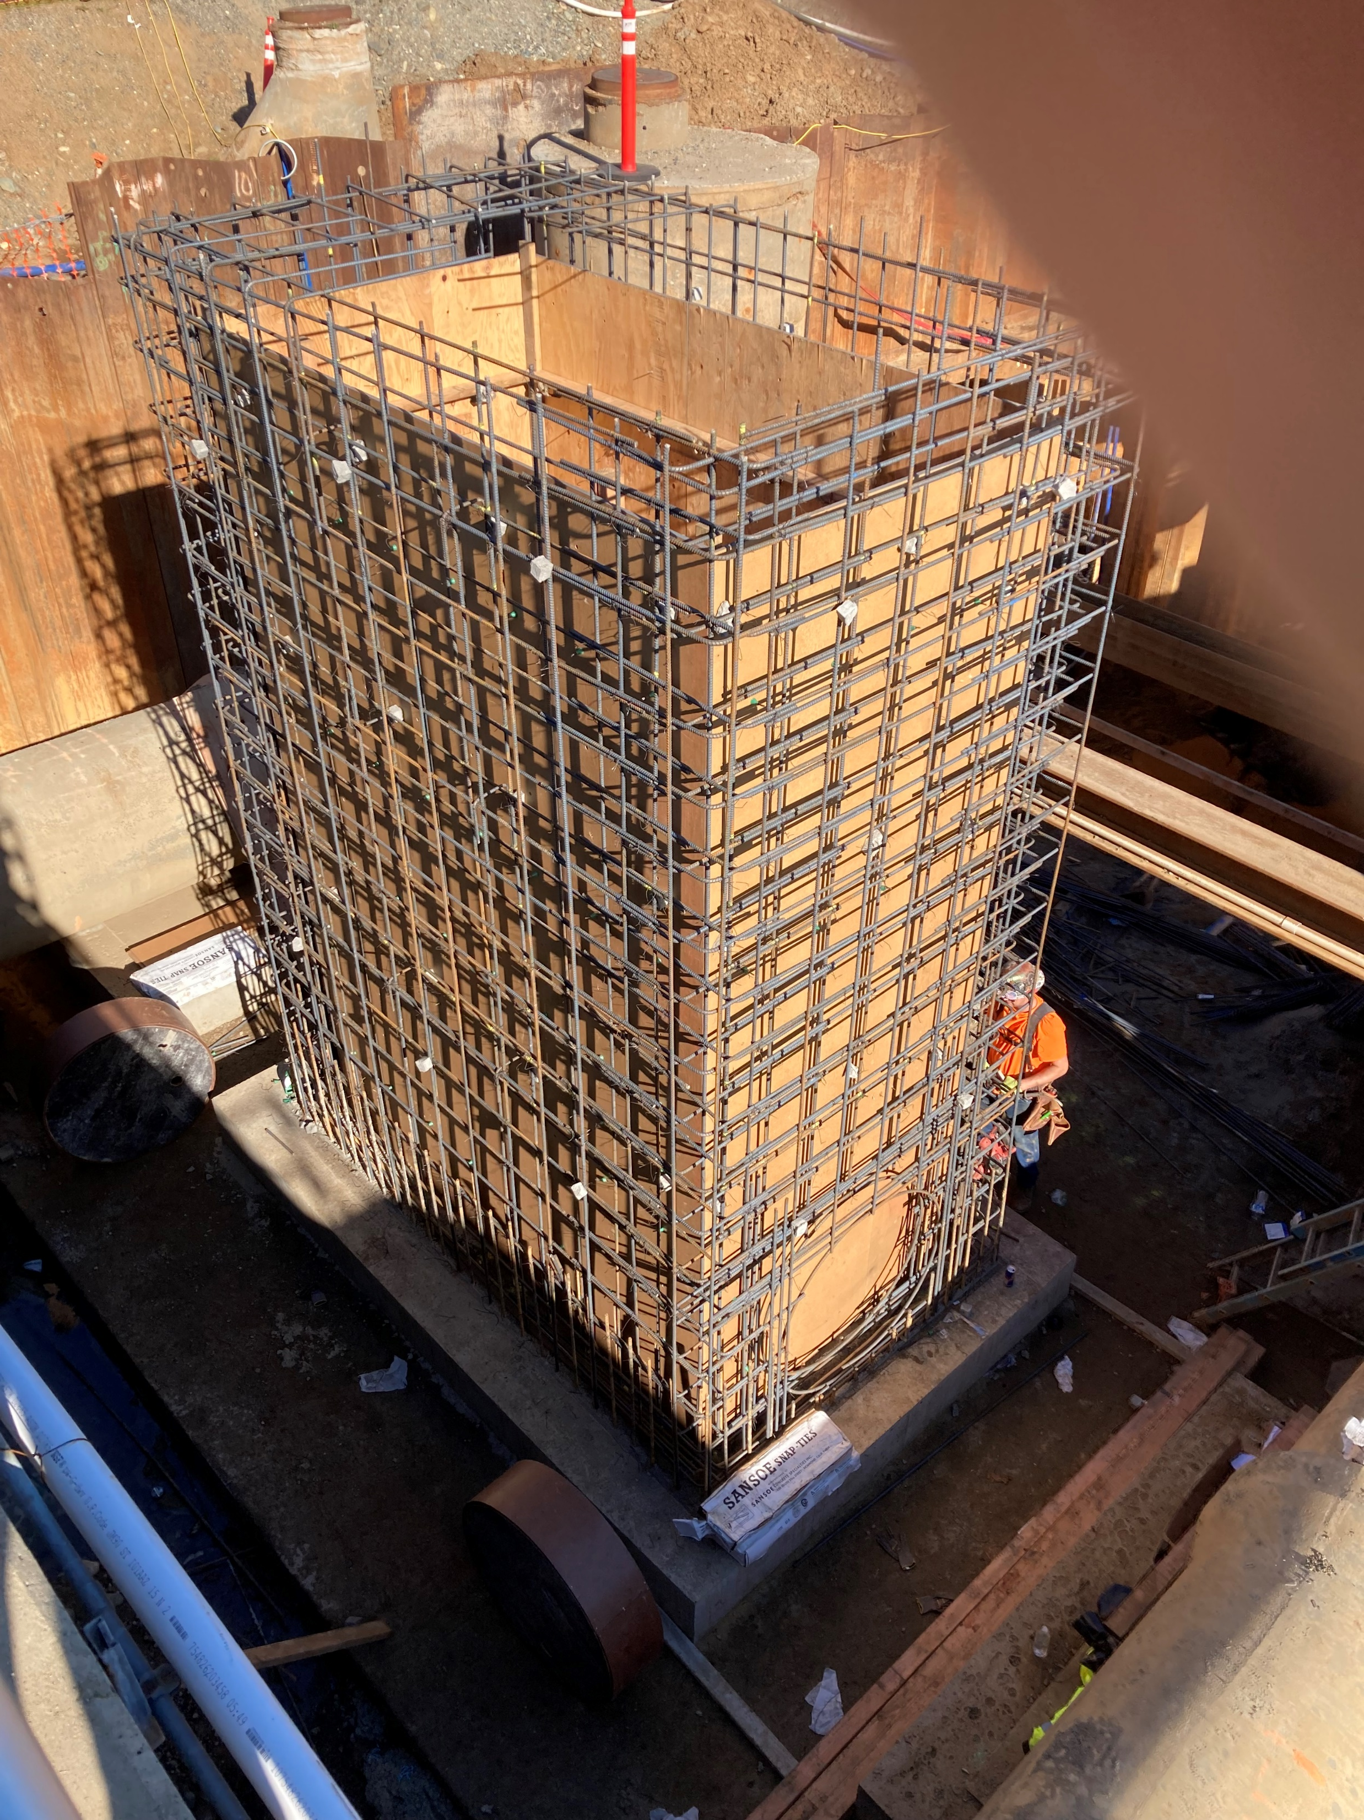

Slide 13
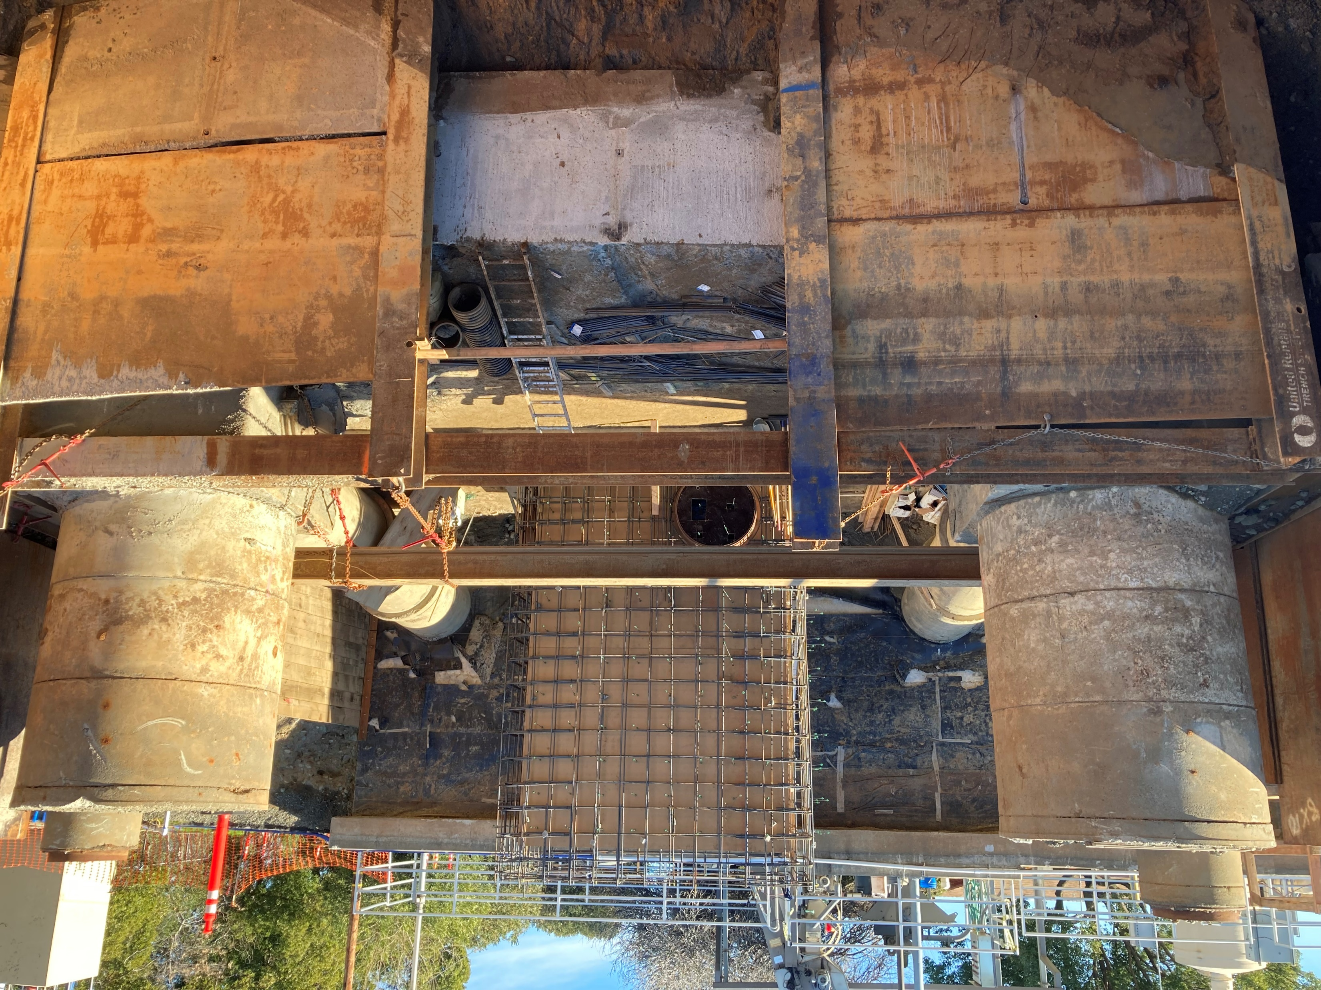

Slide 14
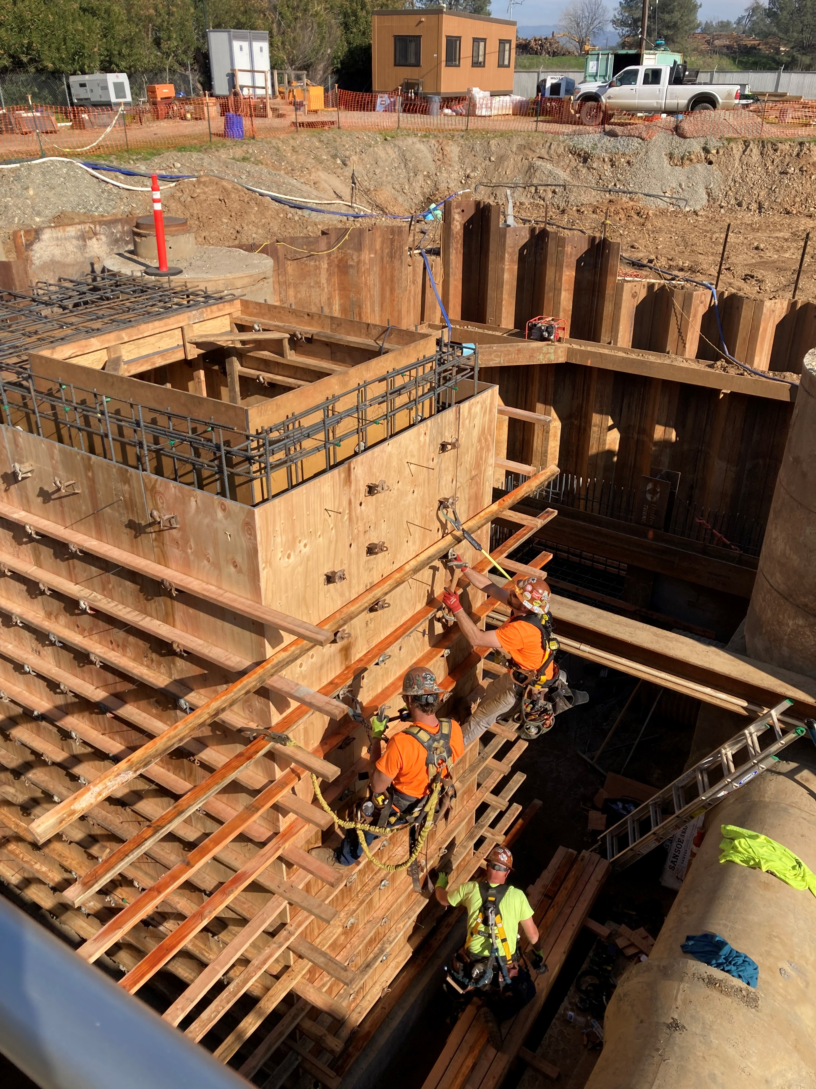
Framing The Exterior Wall of the Bar Screen

Slide 15
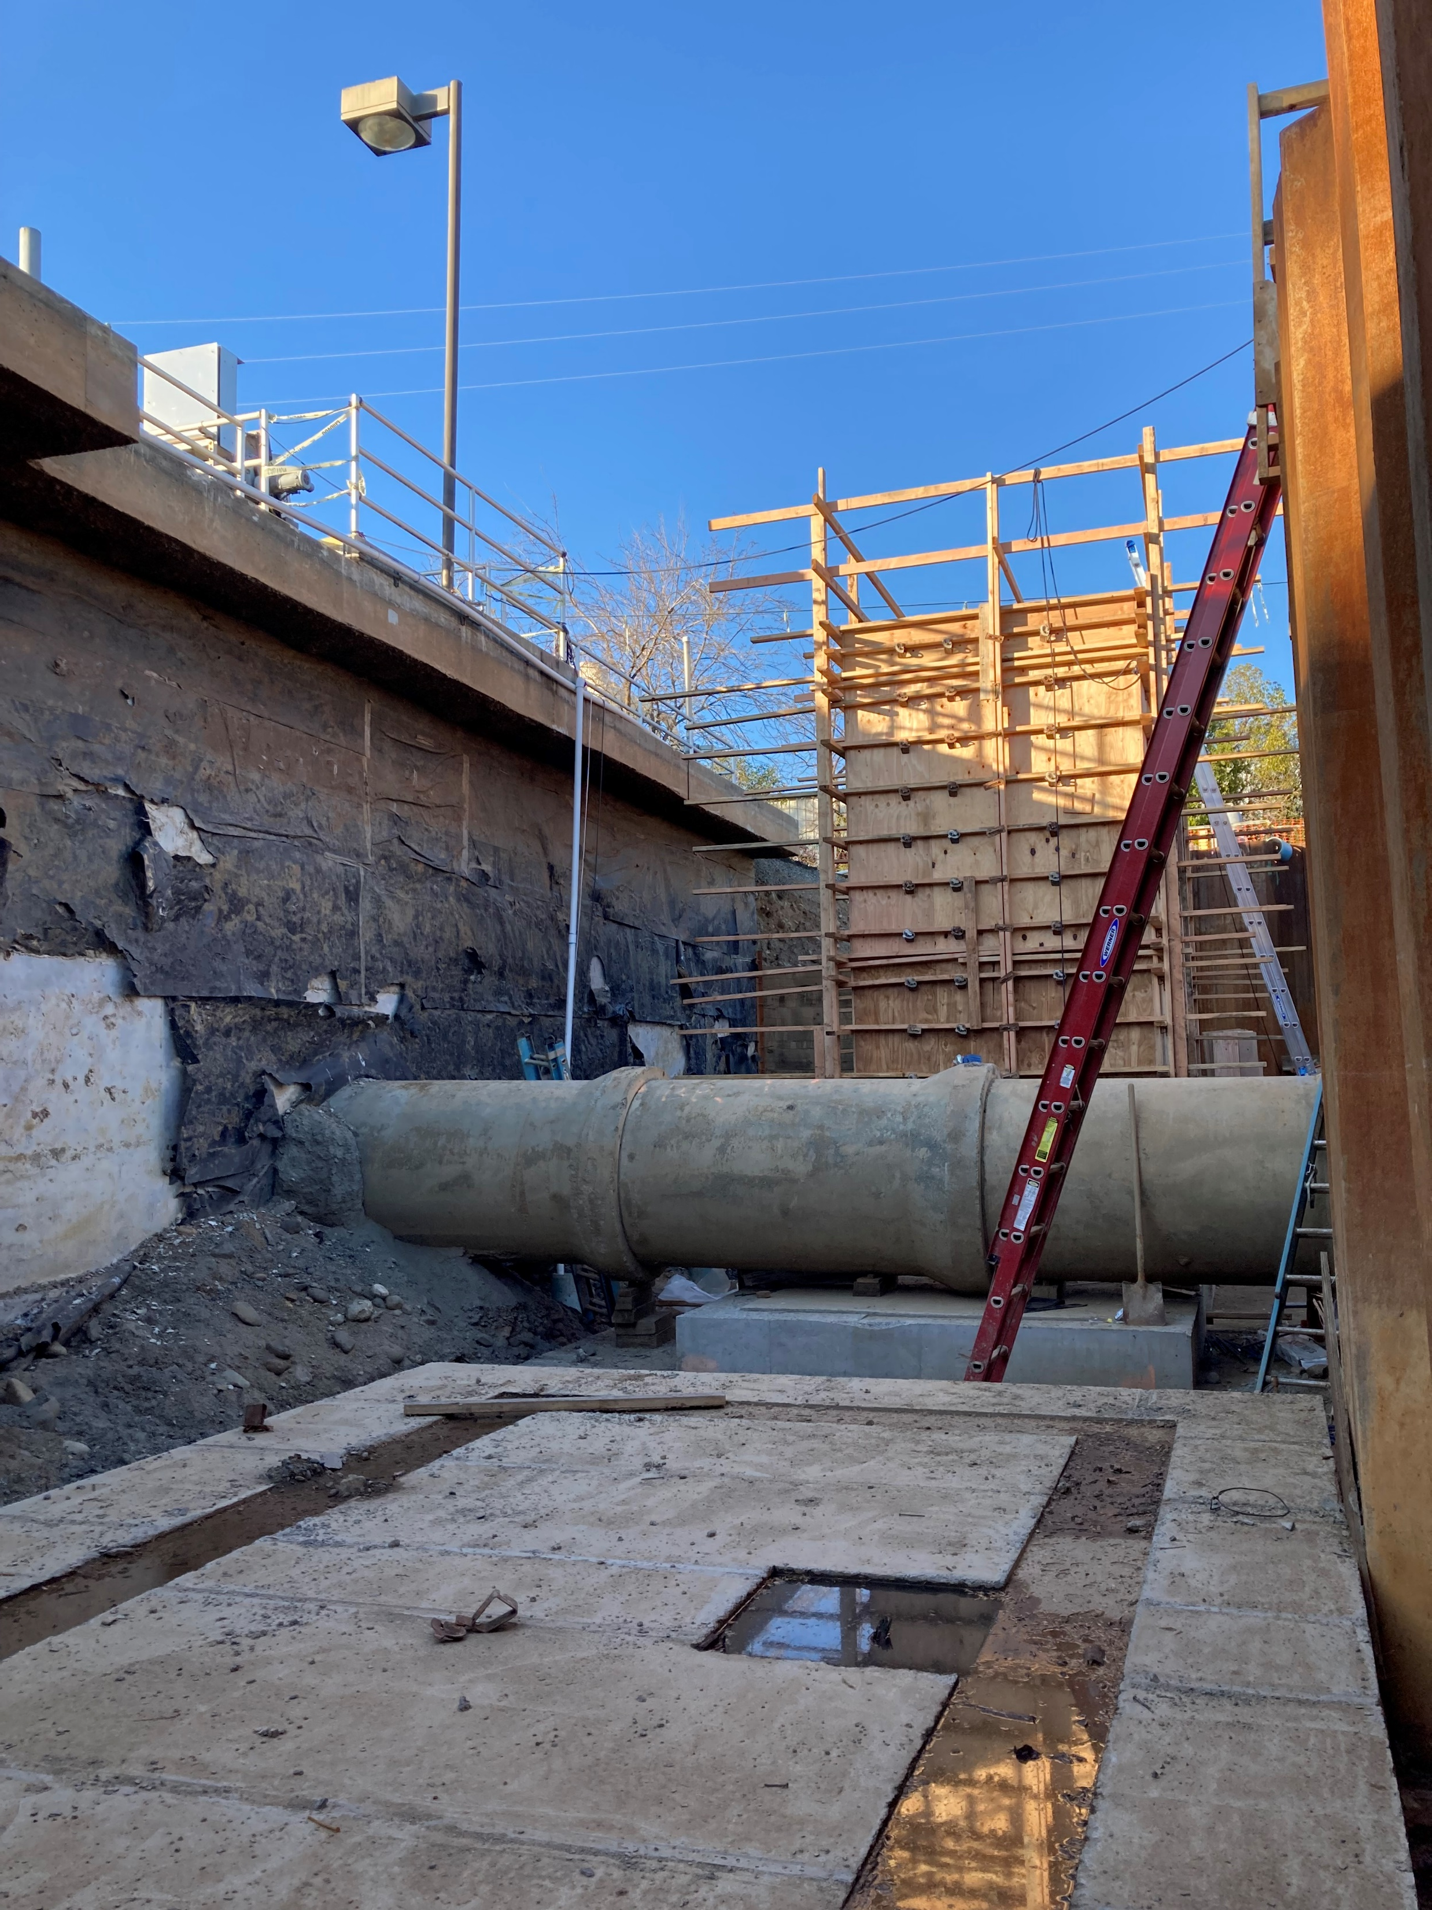
Bar Screen Framing Complete

Slide 16
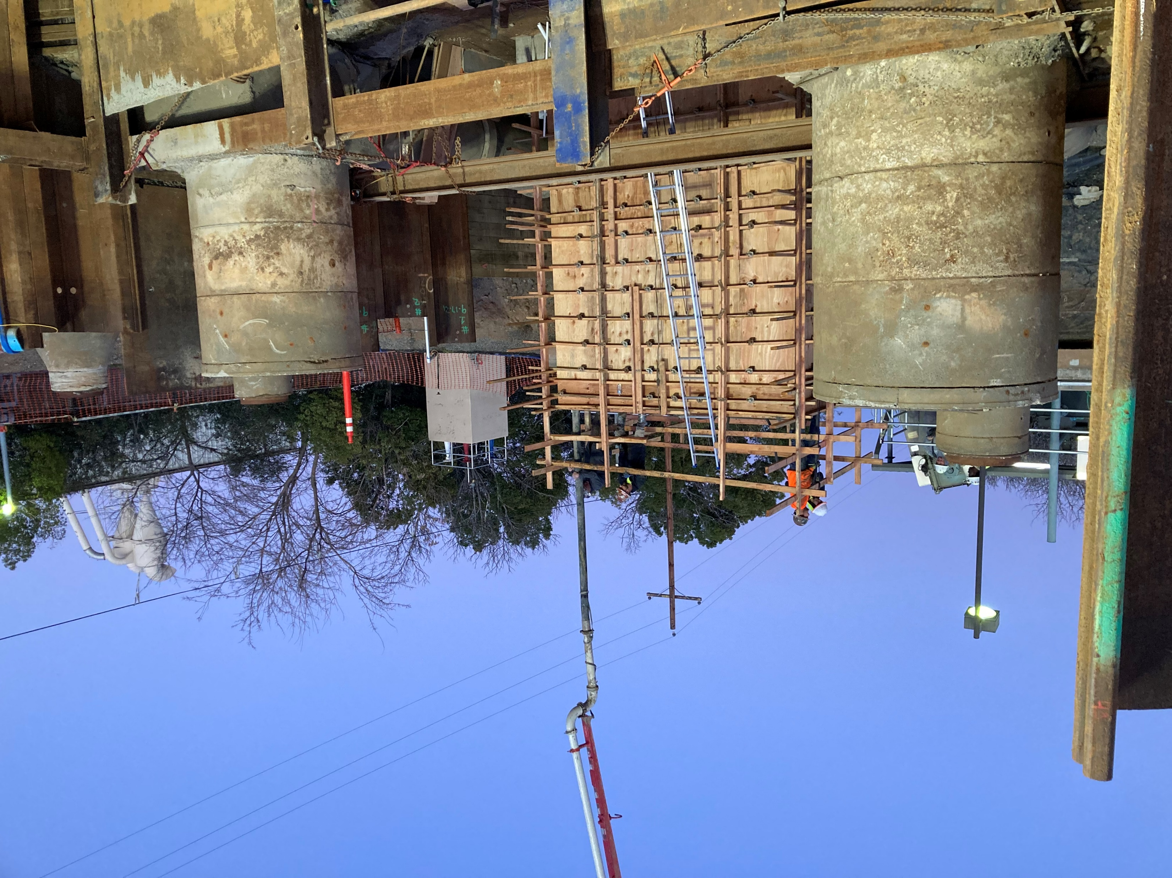
Pumping Concrete for the Bar Screen

Slide 17
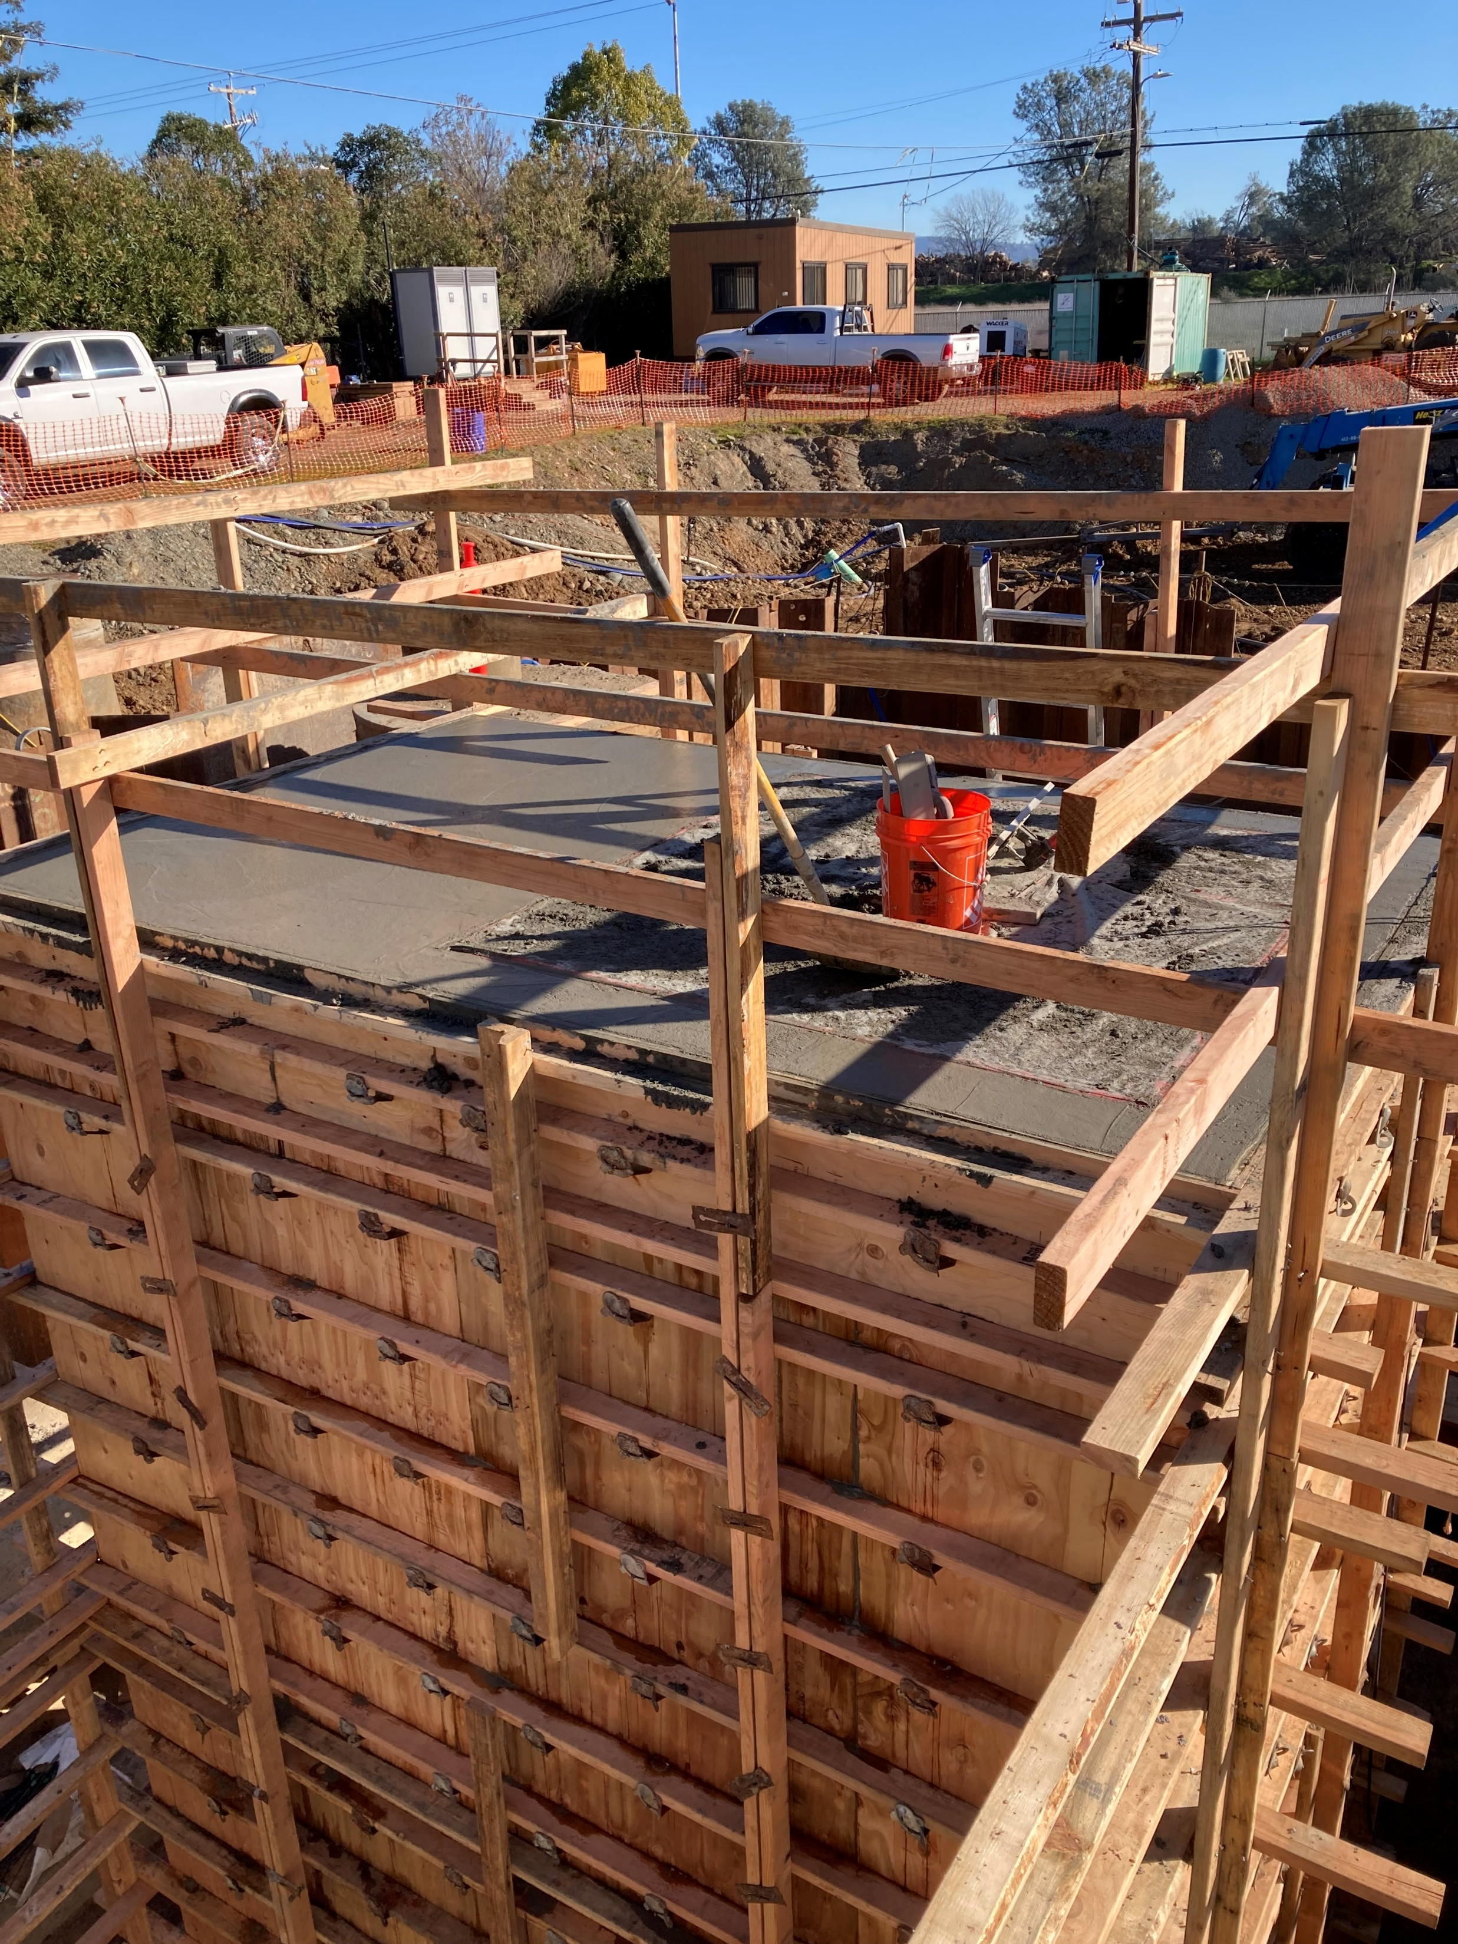
Bar Screen Pour Finished

Slide 18
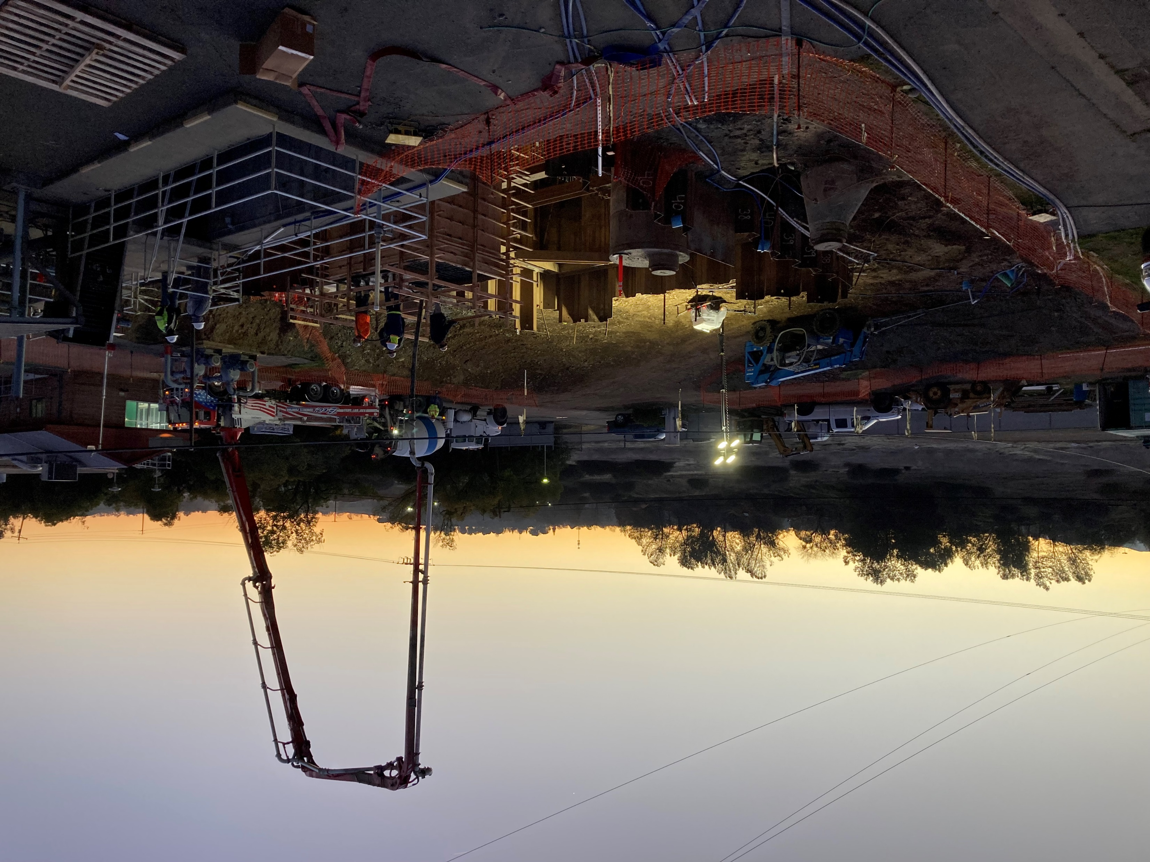

Slide 19
